Slide 1
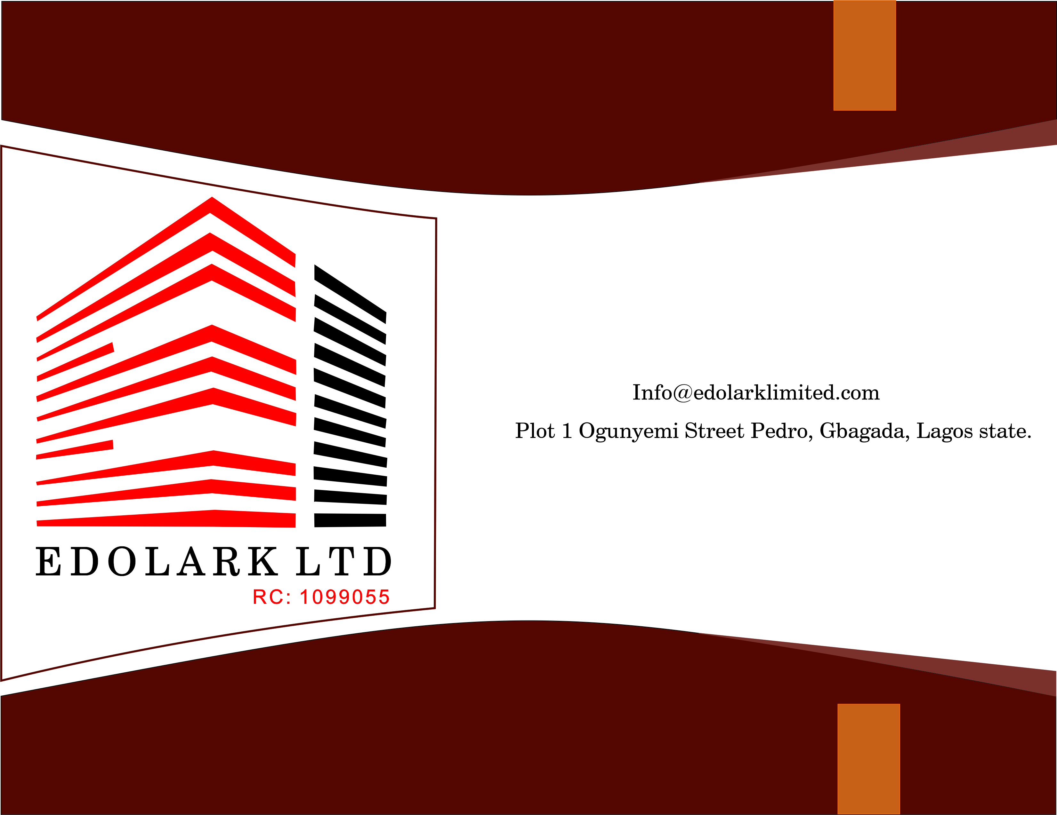

Slide 2
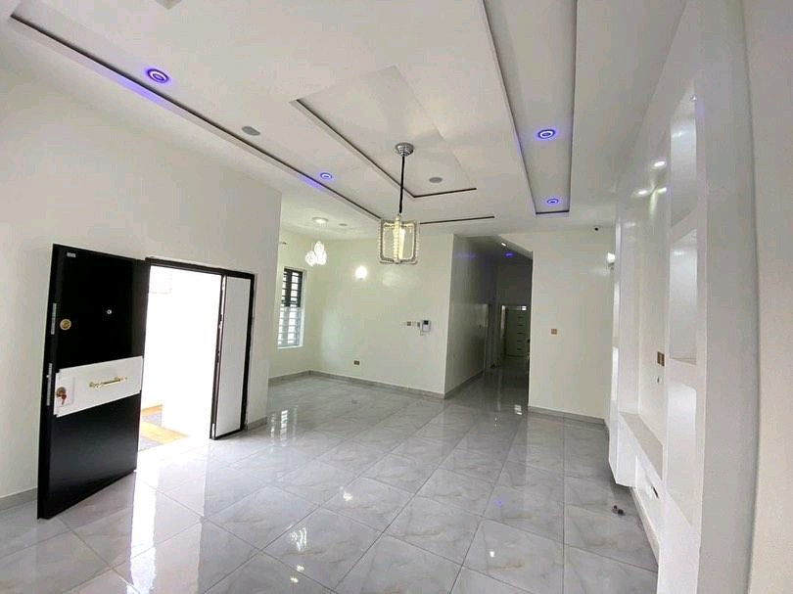
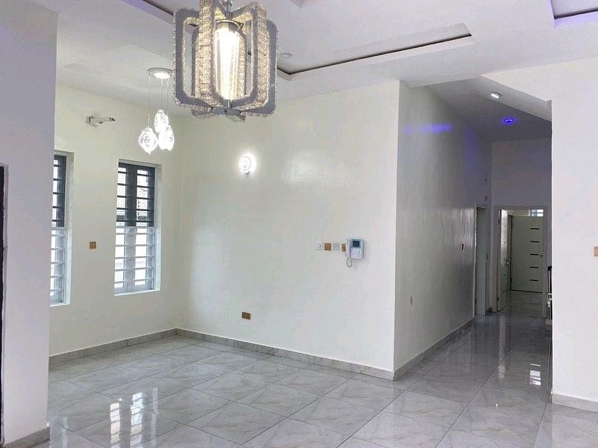
Our Welcome
Message
We are dedicated to help you successfully manage your projects in other to achieve your business and project goals by providing solutions to improve outcomes, and drive value to your organization, your customers and your collaborative partners.

Slide 3
About Us
Edolark Limited was incorporated on the 26th of February, 2013 and registered in line with the Corporate Affairs Commission Act, 1990 of the Federal Republic of Nigeria with Company Registration Number RC 1099055. Our expertise and approach deliver enduring results, true to each client’s specific situation. We are a design, construction and general contract outfit.
Mission
Vision
To be a leading source of professional construction services and project management by combining rare professional skills with quality materials to offer excellent engineering structures at reasonable and earliest possible time to our clients.
To provide quality workmanship and customer service and maintain the highest level of professionalism in our relationships with our customers, employees and vendors.
Goals
Our Approach
To provide a full range of construction products and services to a wide customer base. To grow our business in all sectors of the market place. To provide a customer focused service that delivers high quality construction projects in a safe, professional and timely manner.
Our results are accomplished by working closely with our clients, investing sufficient time to understand their needs, make use of our state-of-the-art knowledge & expertise to render applicable creative resolutions.
Our People
Values
Our people are our real asset that gives us a differentiated presence. We are passionate about making a noticeable impact in every service we render.
With positive attitudes, respect and fairness to all of our clients, we find solutions. follow company standards and systems and endeavor to exceed client’s expectations.

Slide 4
Our Services
Building Design & Construction
Renovation and Modification
We offer state of the art, and professional building designs, construction, and installations with precision for individual and governmental institutions.
As one of our area of specializations, we repair buildings and carry out preventive maintenance of systems.
Project Management
Maintenance Services
We make project recommendations and its implementation, integrate our client’s mission and goals for a successful completion of the project in stipulated time.
As one of our area of specializations, we repair buildings and carry out preventive maintenance of systems.
Landscaping and Beautification
Procurement
Beauty of property is incomplete if the gardens or lawns are not properly designed and managed. We beautifying environment by offering professional landscape architecture services.
We offer effective supply of goods and services at a favorable cost implication to meet client’s demand in terms of quality, ensuring safe handling of goods, supply in and avoiding delay in delivery of goods.

Slide 5
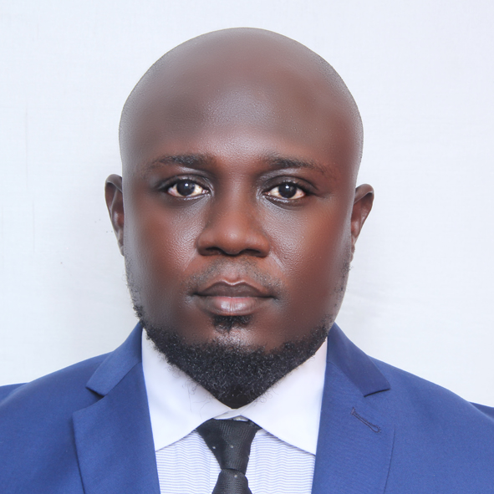

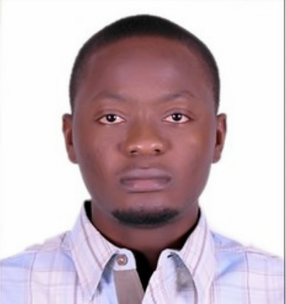
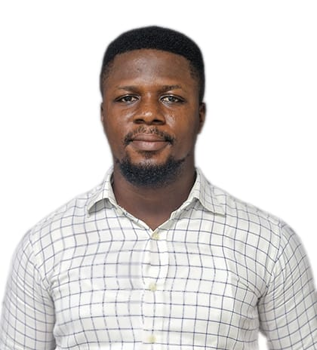
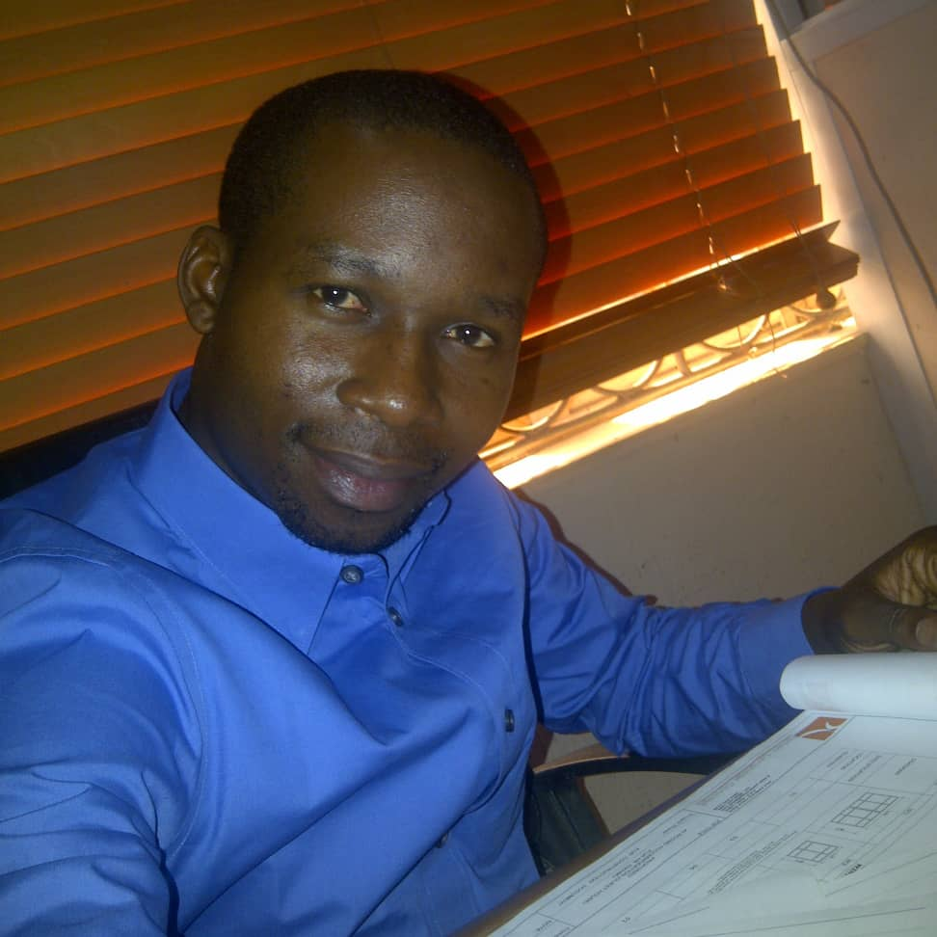
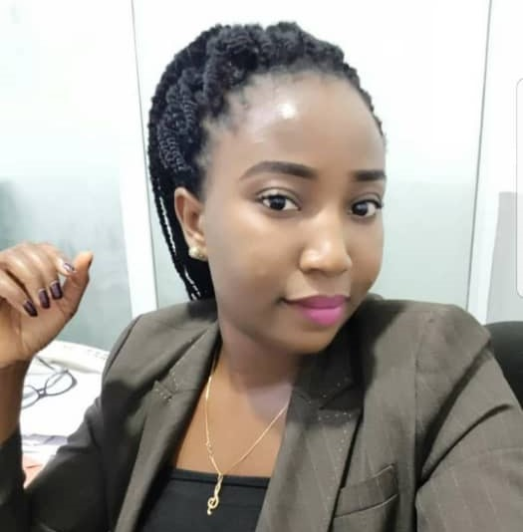
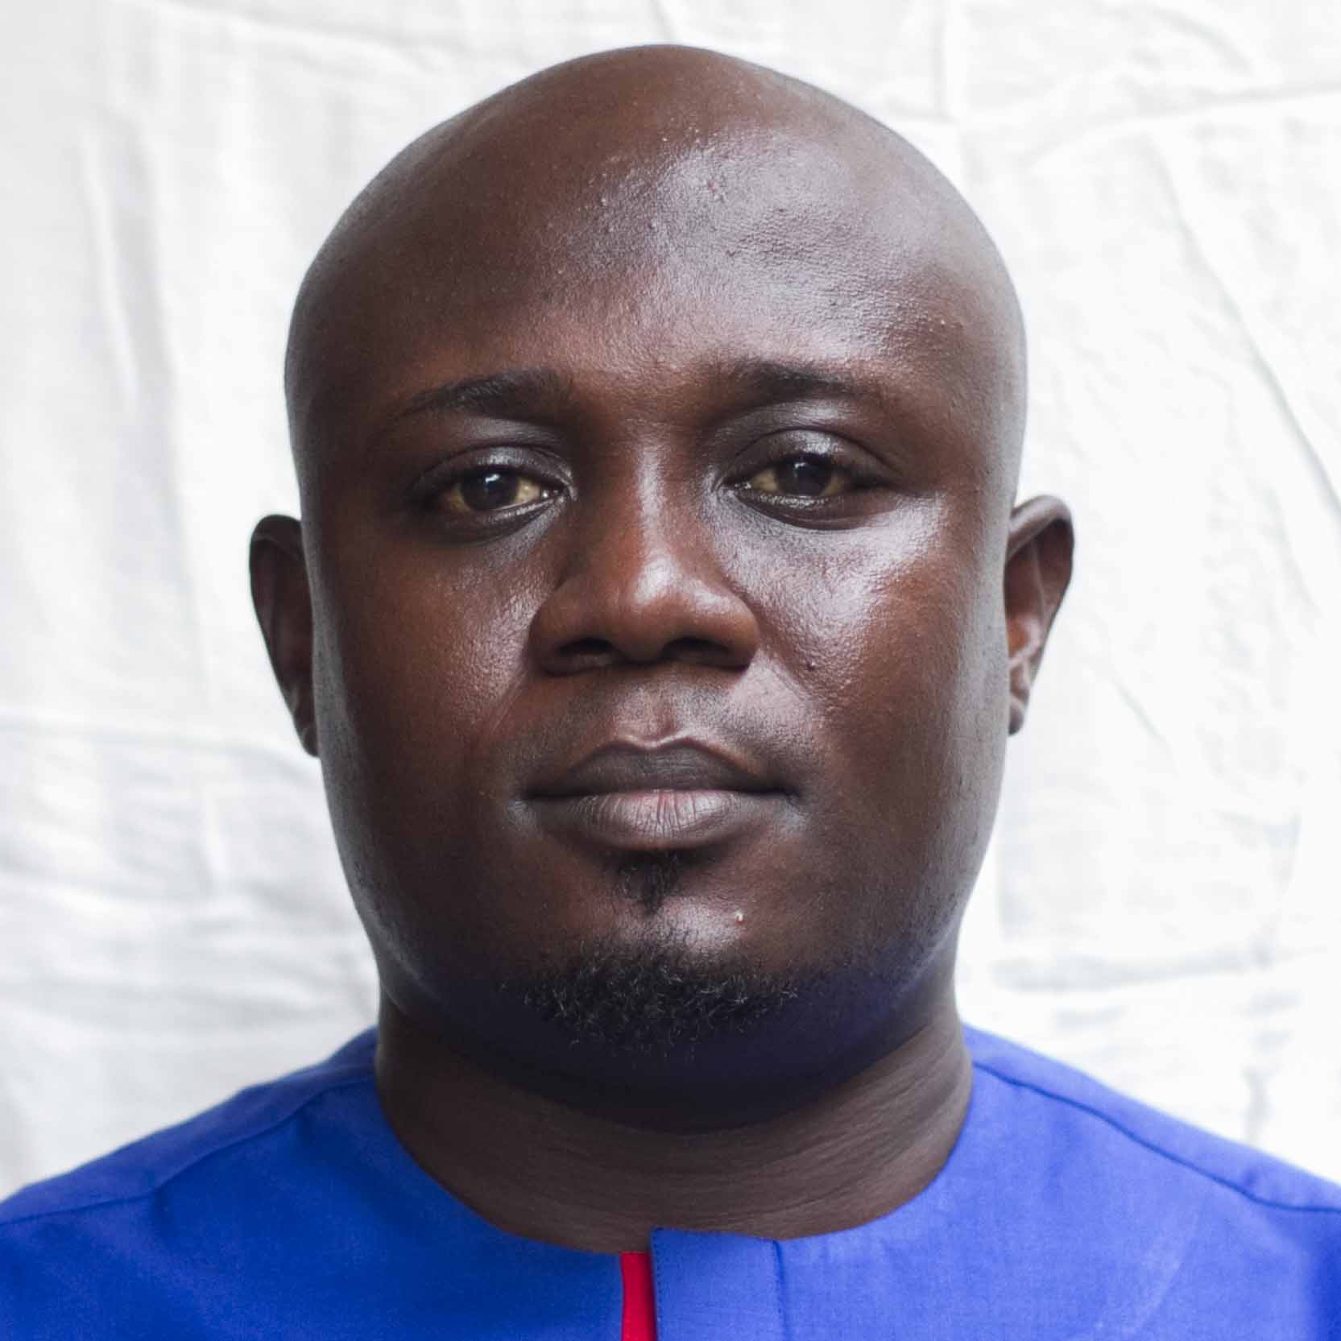
Meet our Outstanding Team
Our priority is to conquer high level of satisfaction for our clients and this is why we have reliable and credible members in our team.
Kolade Awoyera
Olalekan Oginni
Aramide Olalekan
Damola Awoyera
Sanyaolu Damilola
Managing Director
Senior Architect
Civil Engineer
Quantity Surveyor(NIQS)
Accountant
Civil Engineer and certify project manager with over 17 years of experience in road and building construction.
Registered Architect with over 14 years experience in both commercial and residential building design, modification and beautification.
Registered Civil Engineer, with over 10 years experience in structural design and construction of Civil Engineering structures.
Licensed quantity surveyor with over 13 years and vast experience in cost control, management and estimations.
Chartered Accountant with 3 years of robust experience in auditing, certification and negotiation.

Slide 6
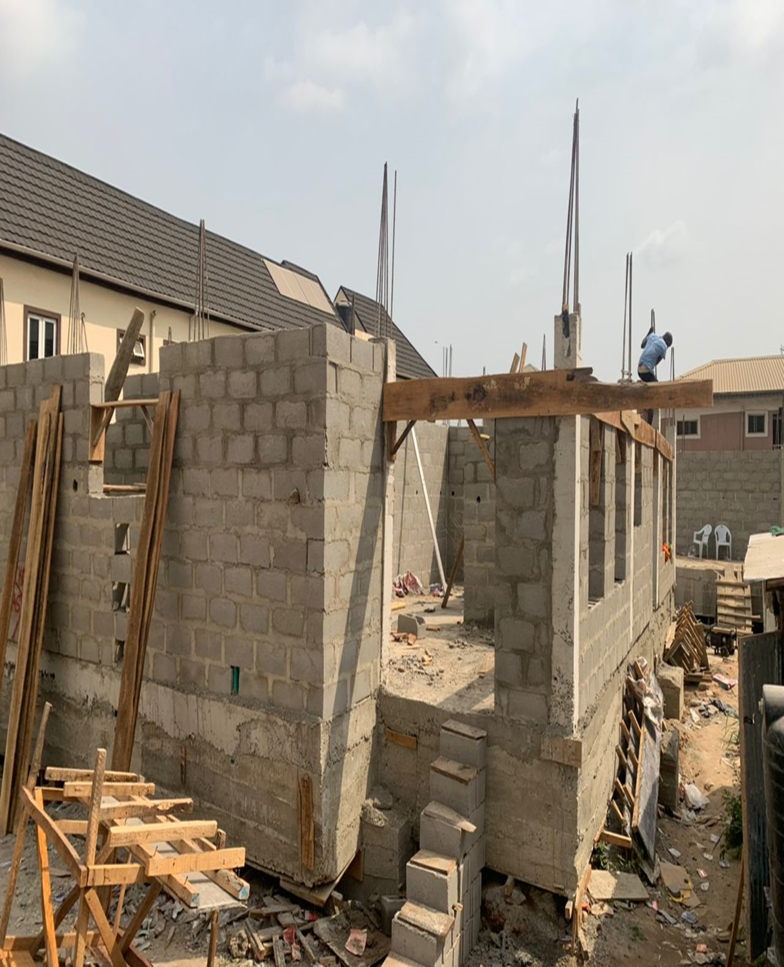
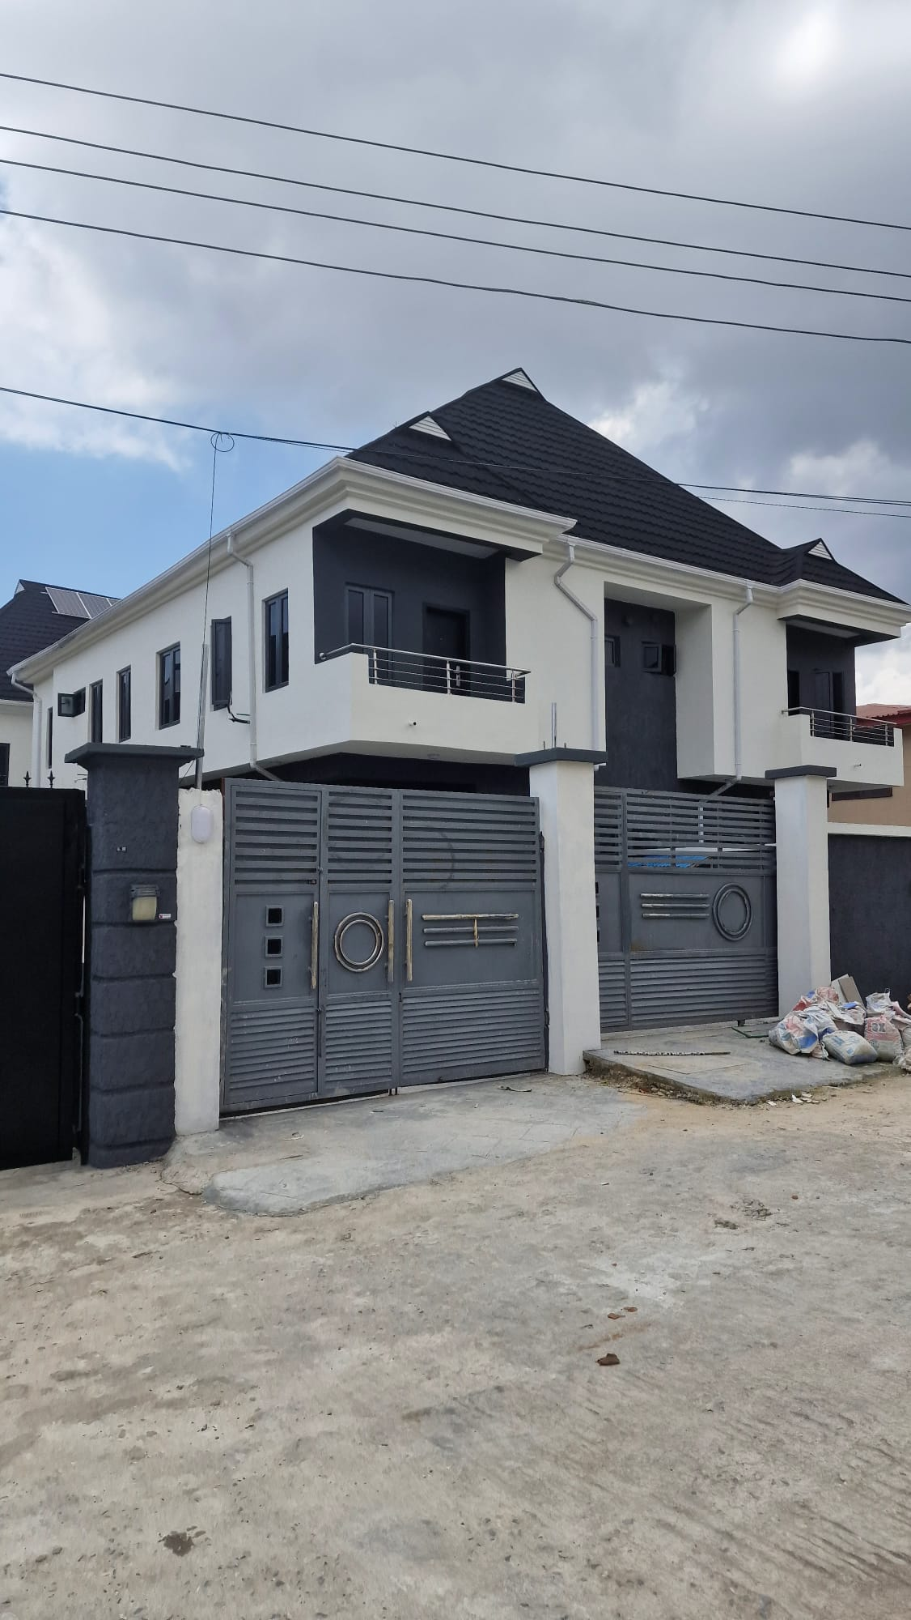
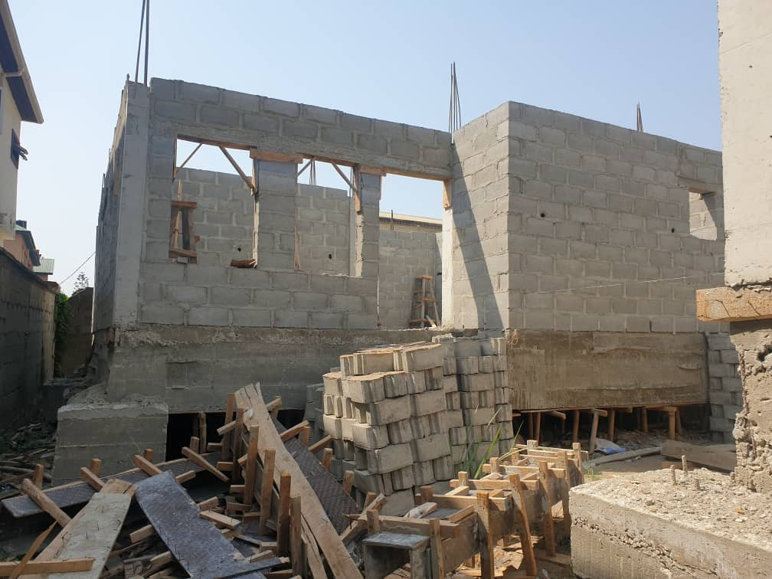
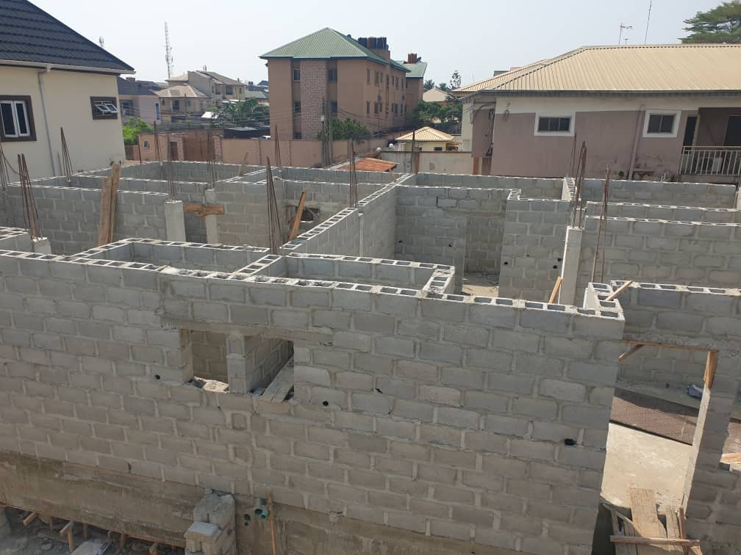
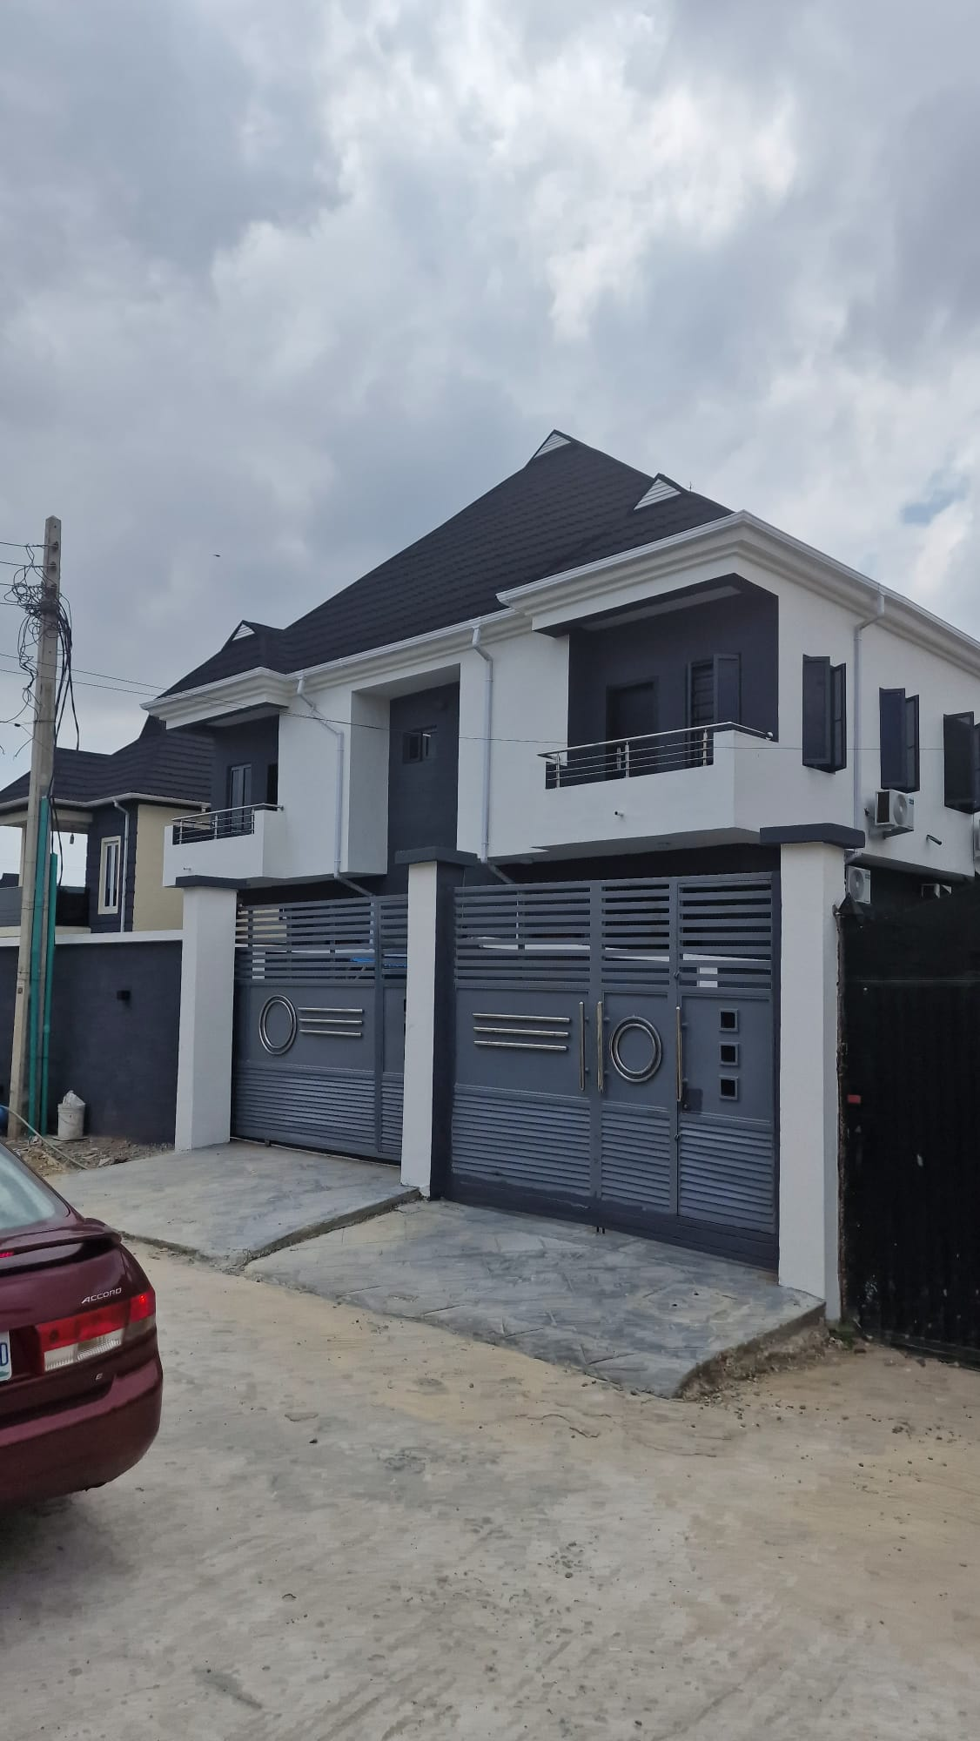
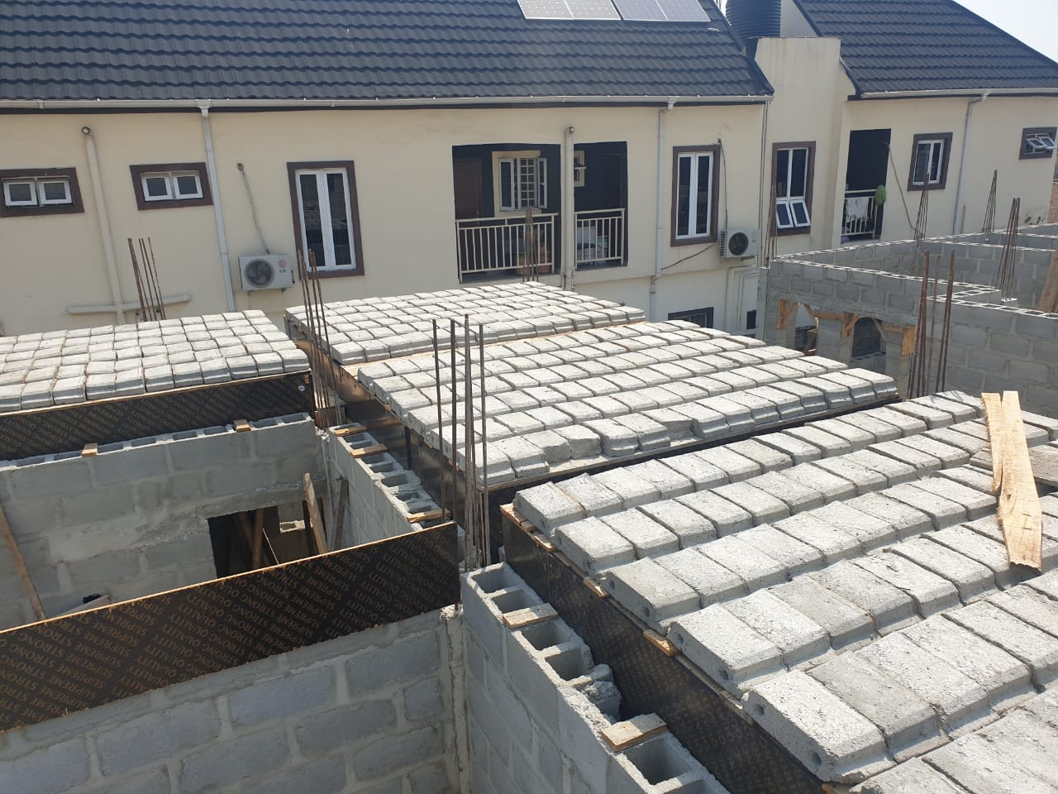
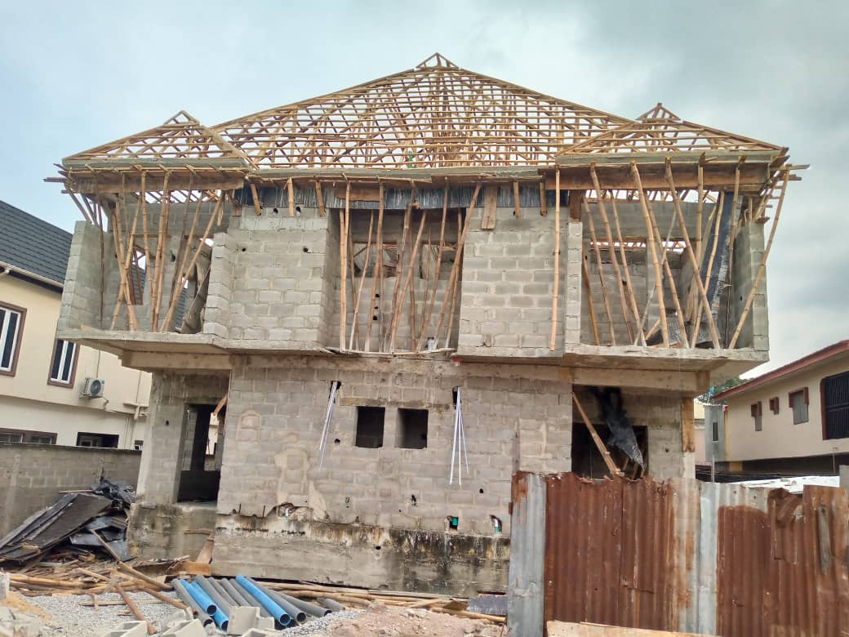
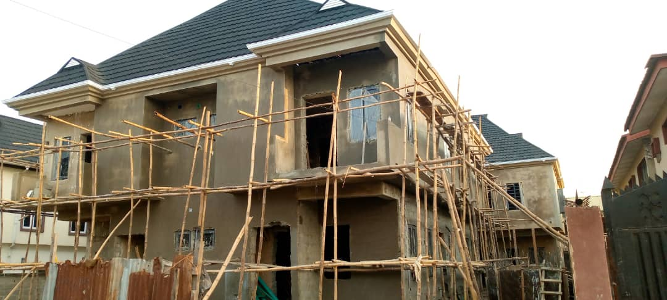
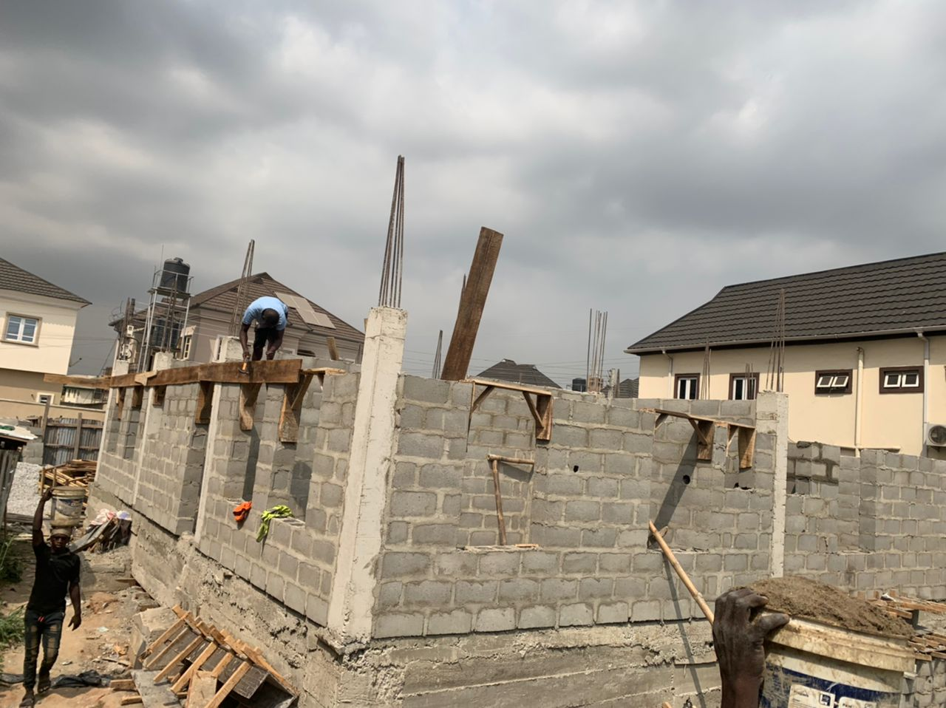
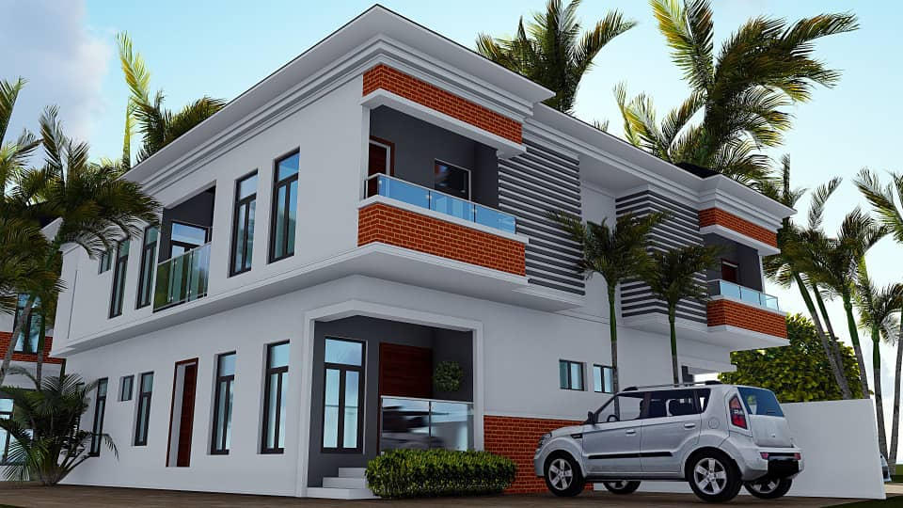
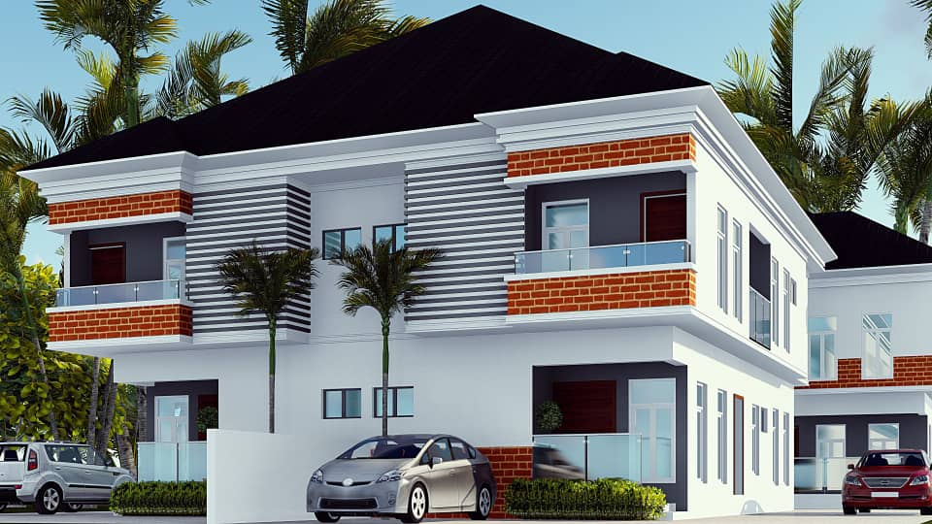
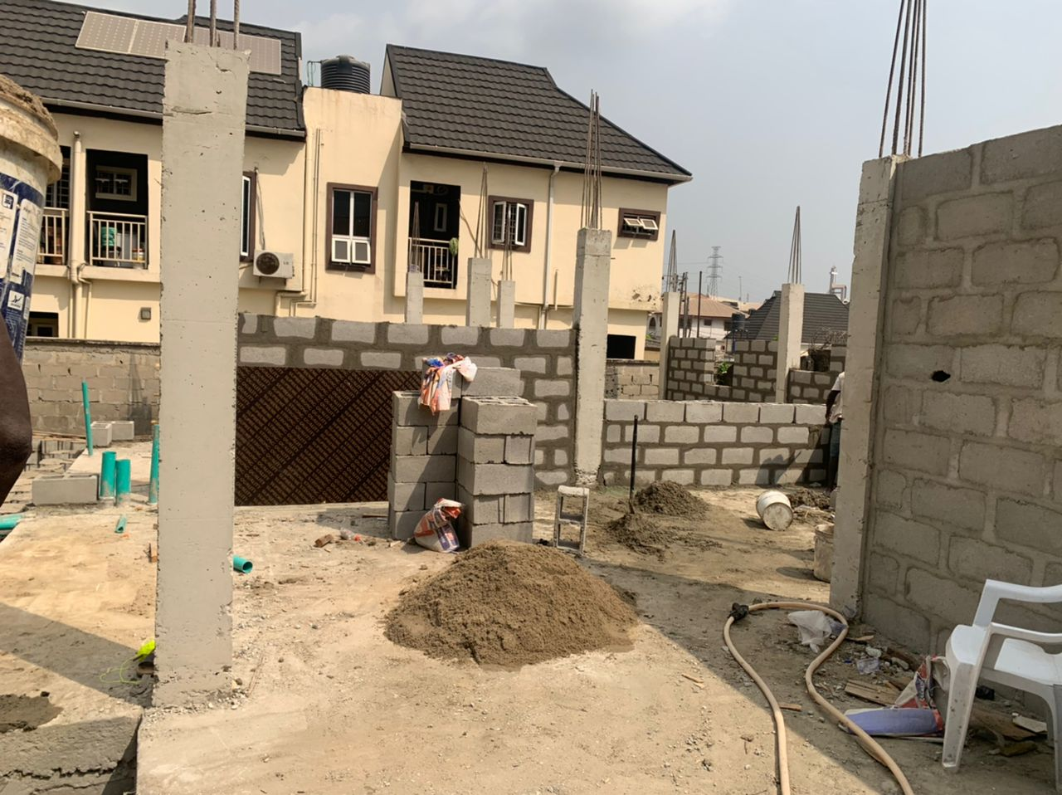
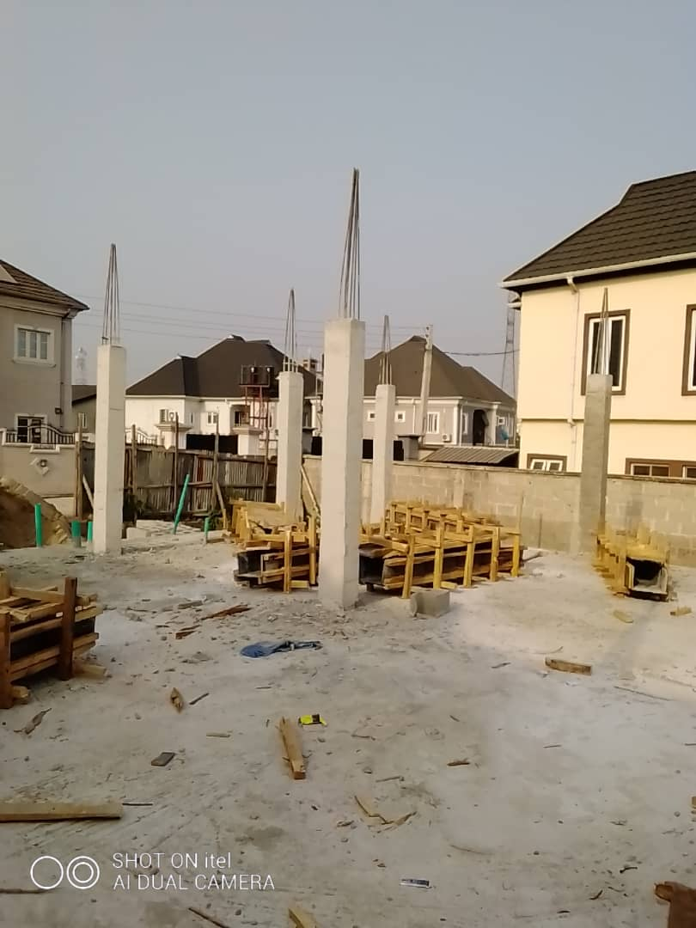
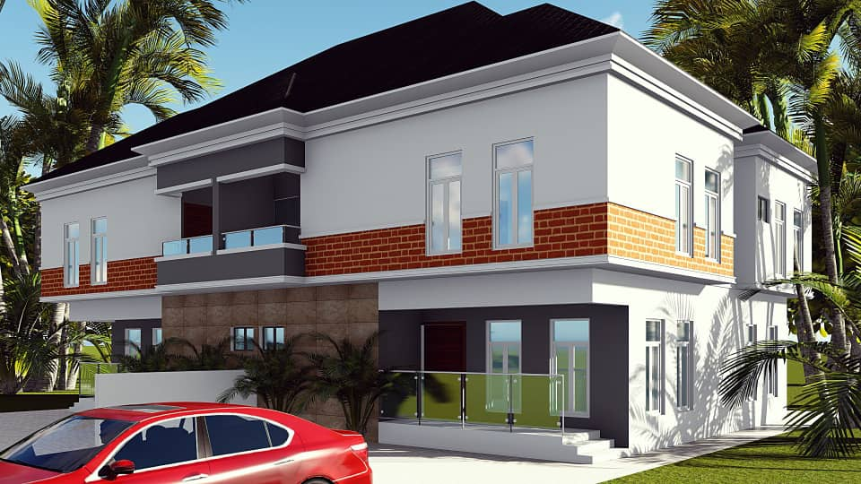
2 No 4 Bedroom Semi Detached Residential Apartment at Medina Estate, Gbagada.
JOINT VENTURE WITH MR JERRY CHIMEZIE EYIMUCHE
Completed 2021

Slide 7
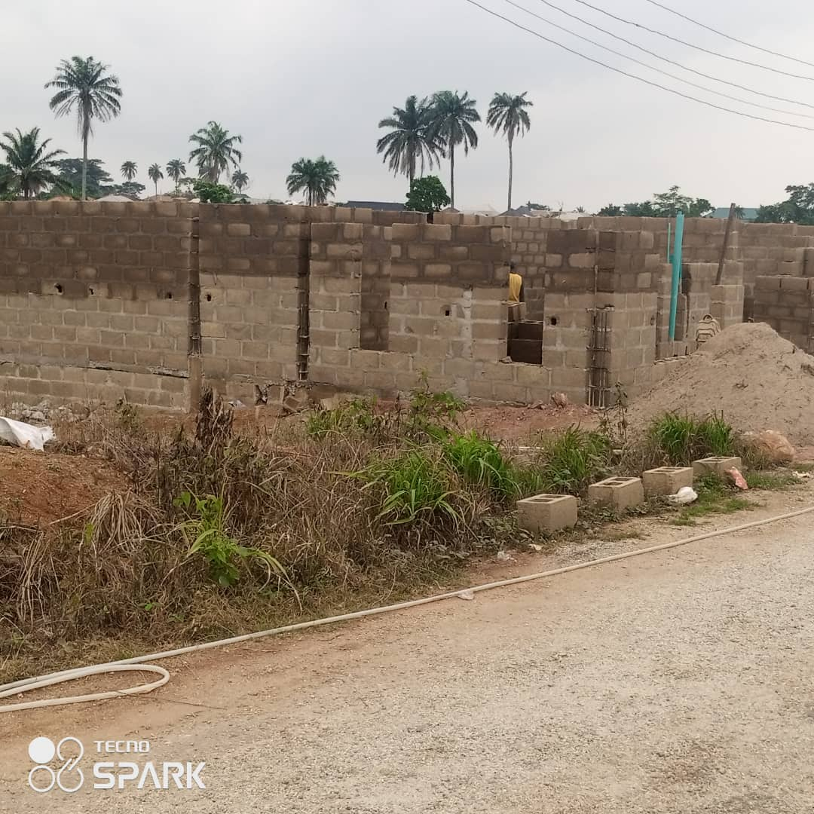
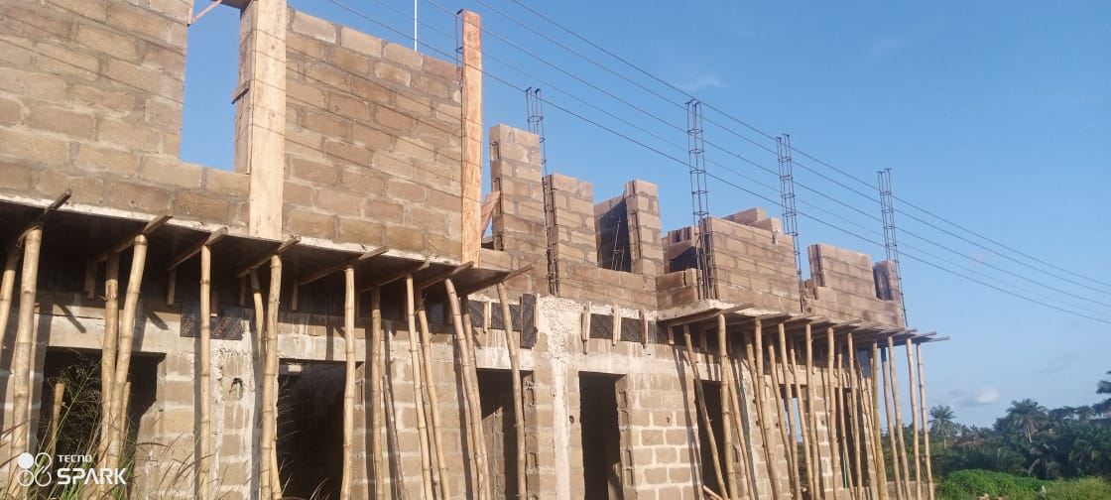
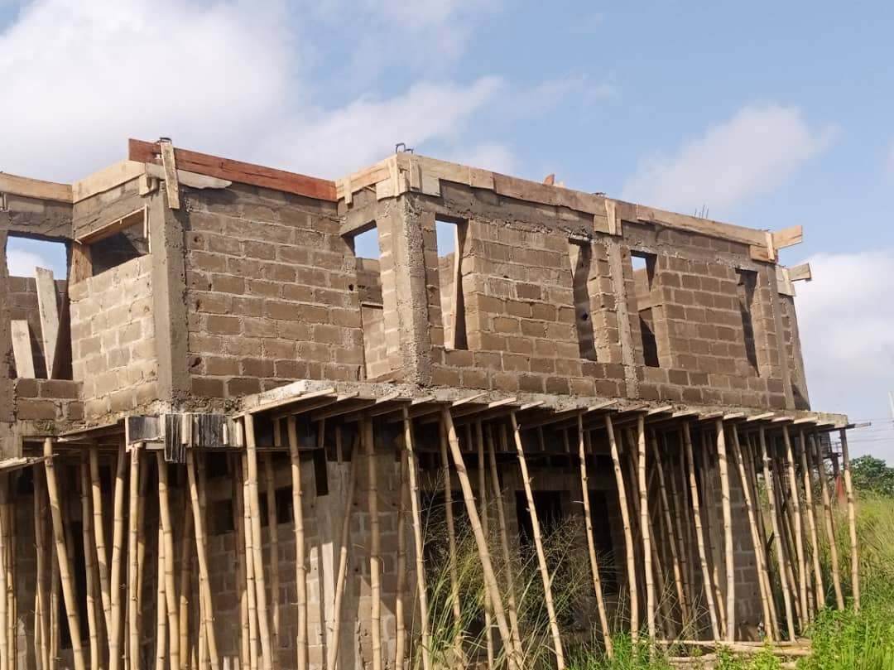
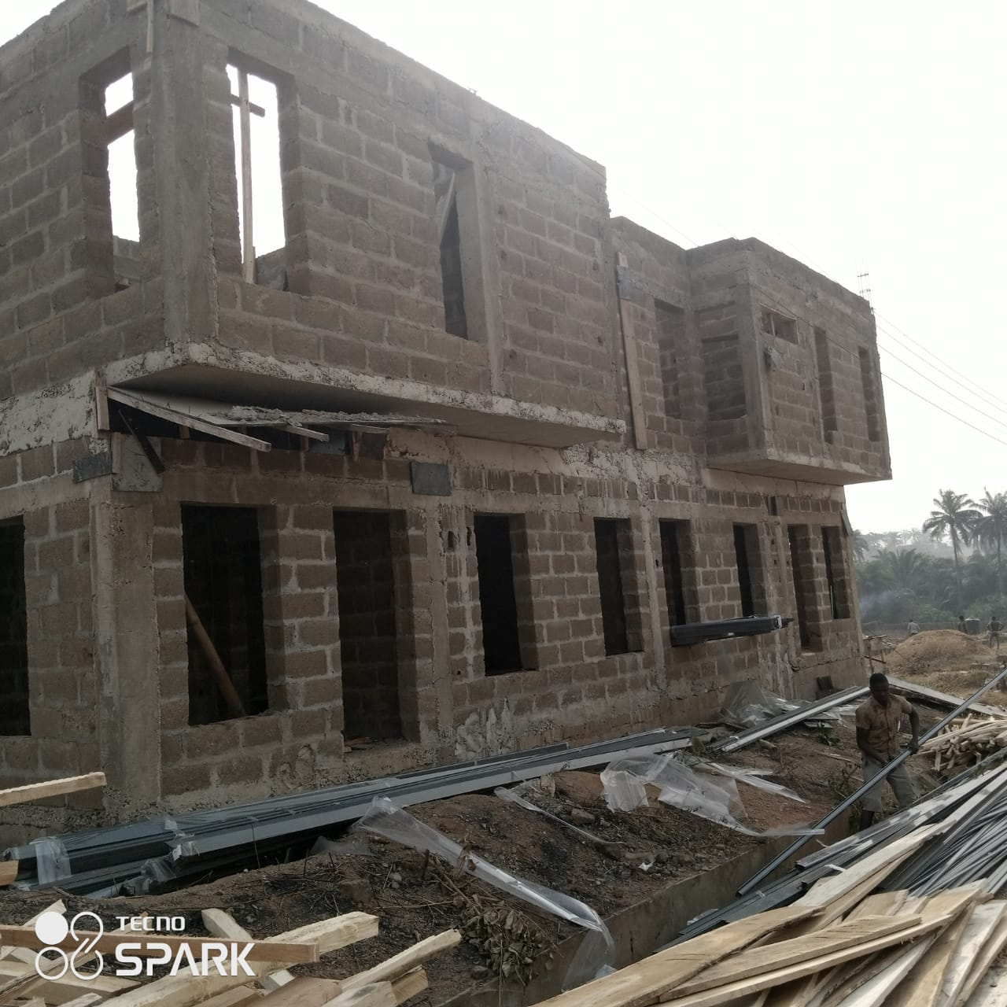
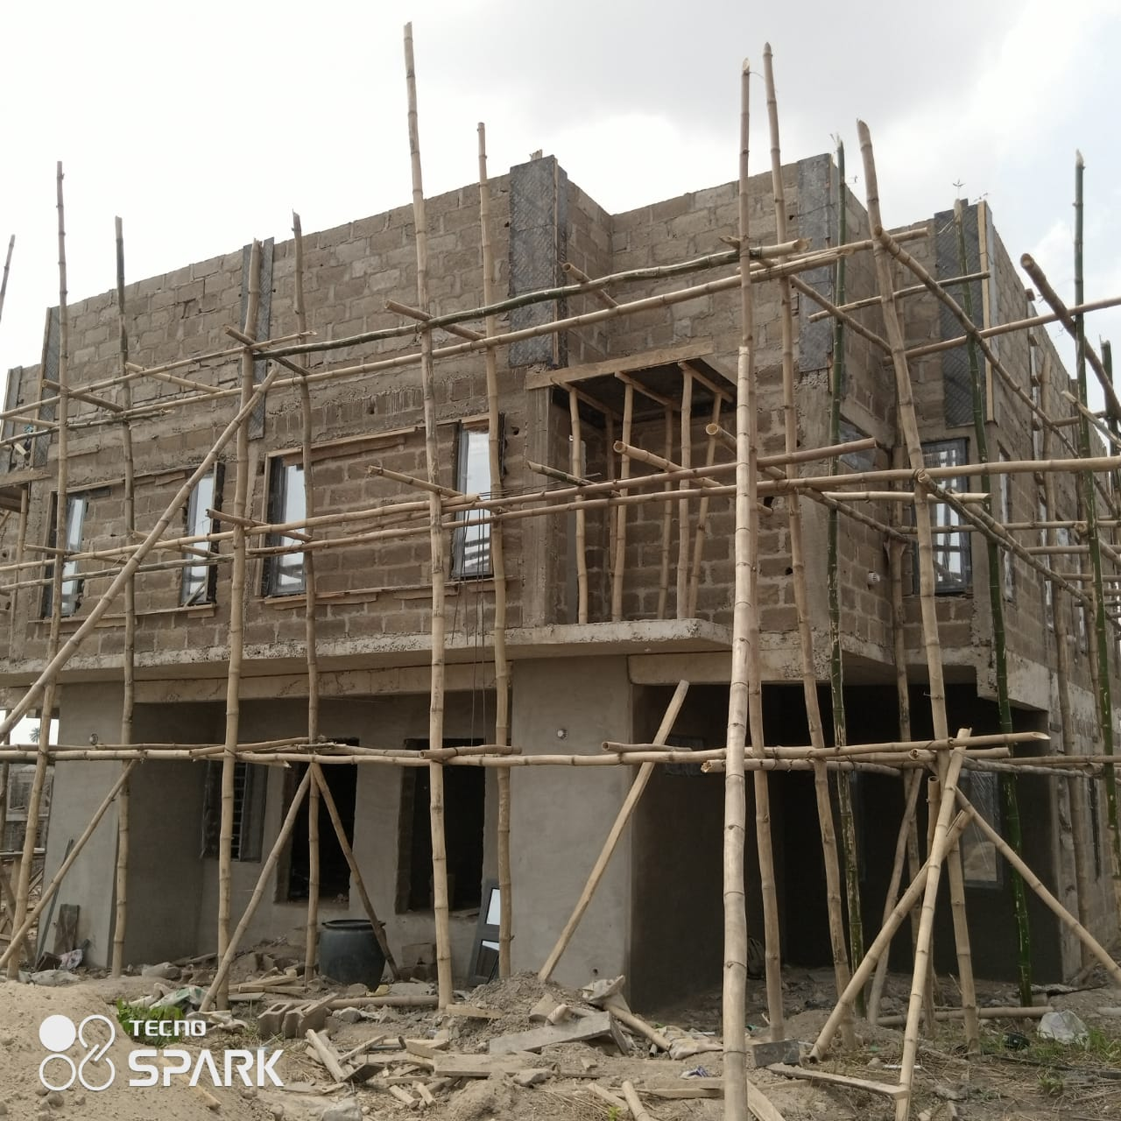
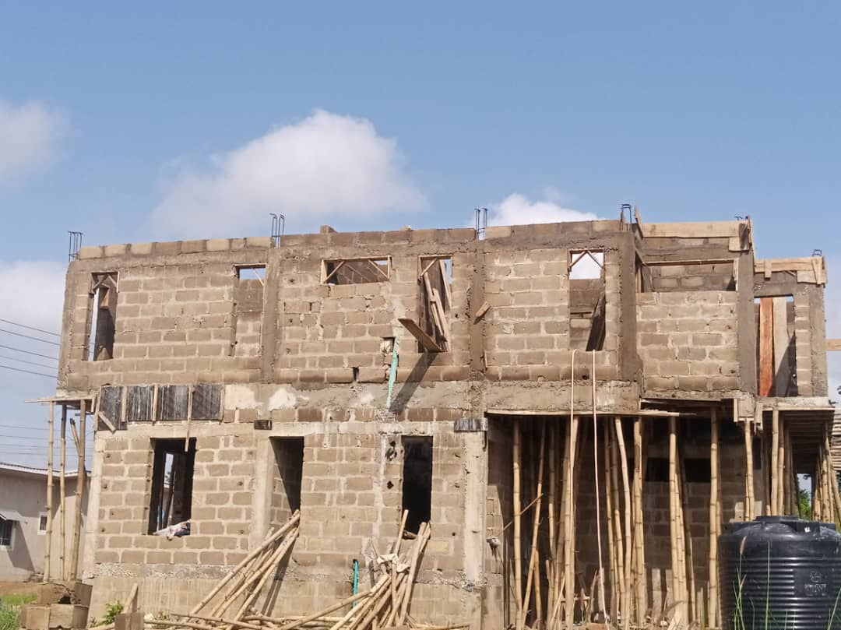
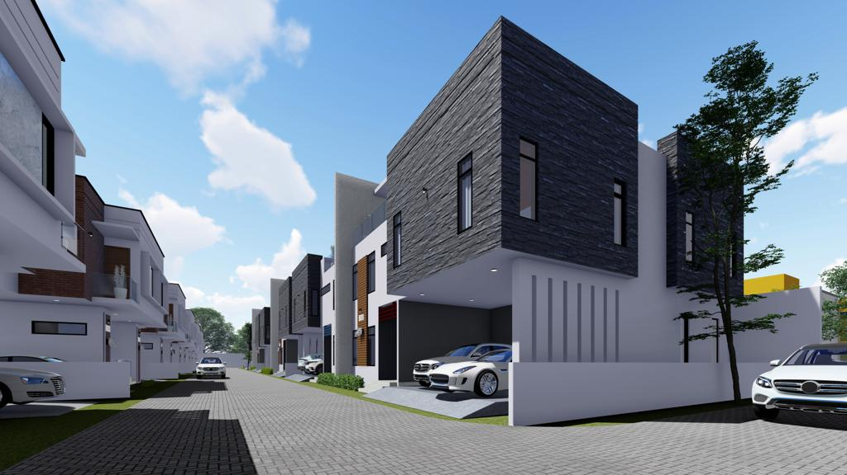
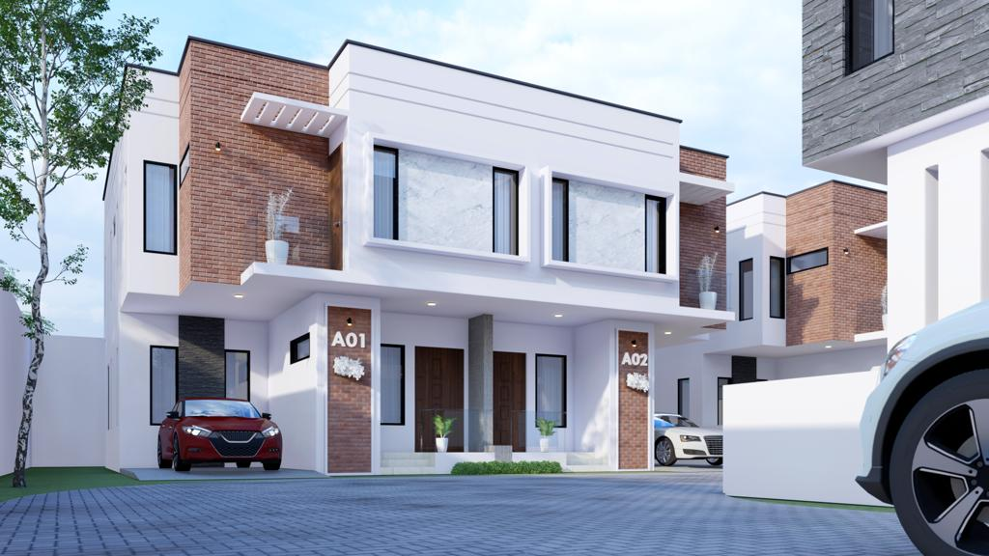
2 No 3 Bedroom Semi Detached Residential Apartment at Palms Gardens, Osogbo.
Client: SYNERGY DEVELOPMENT LTD
Contract Sum: 247 Million Naira

Slide 8
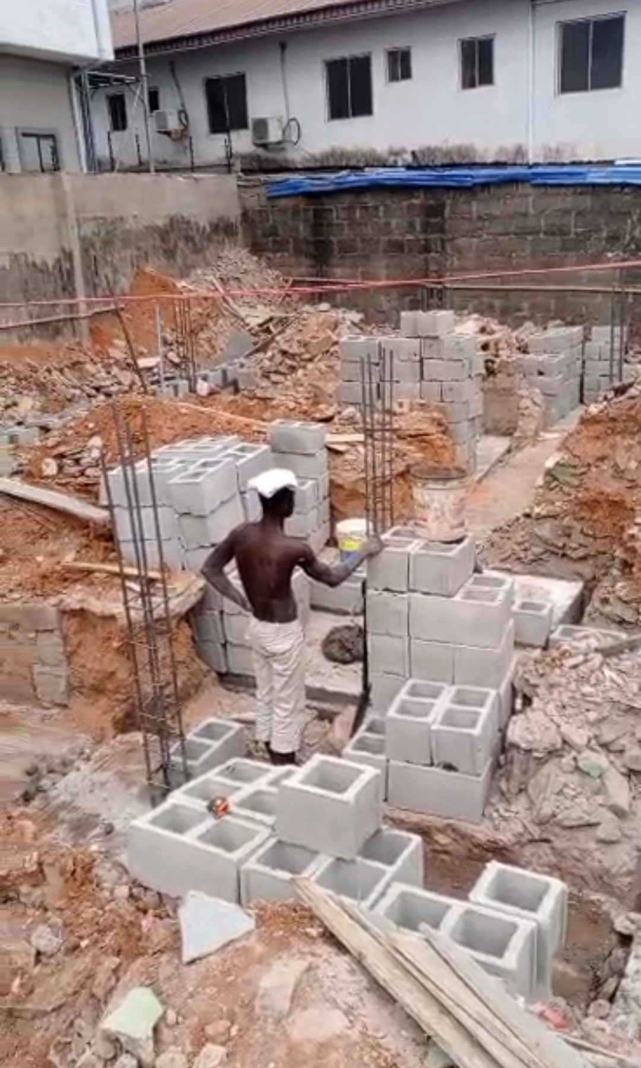
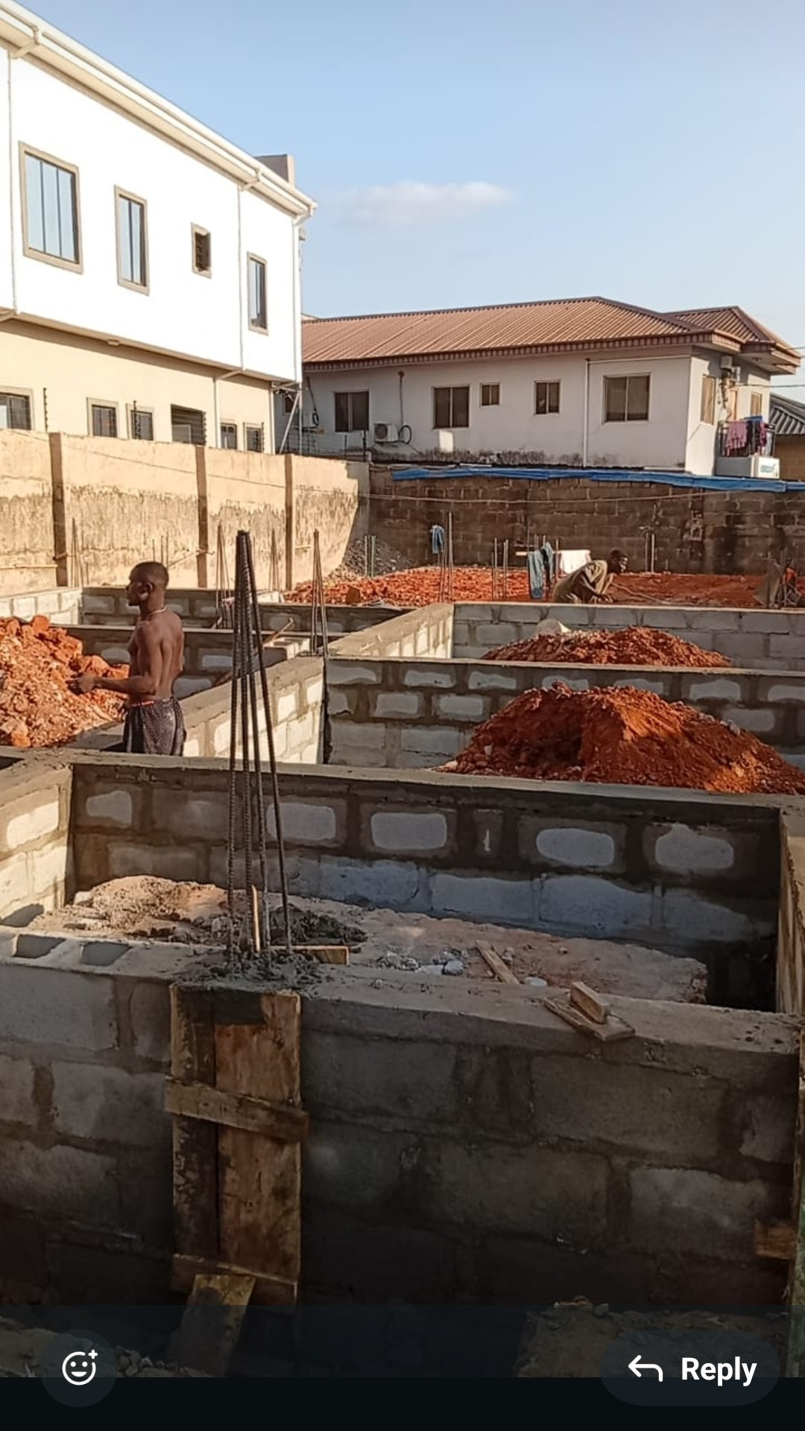
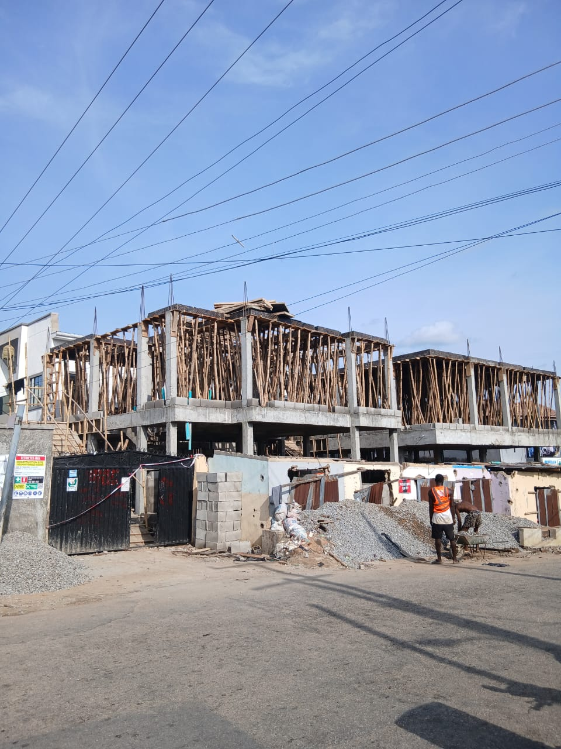
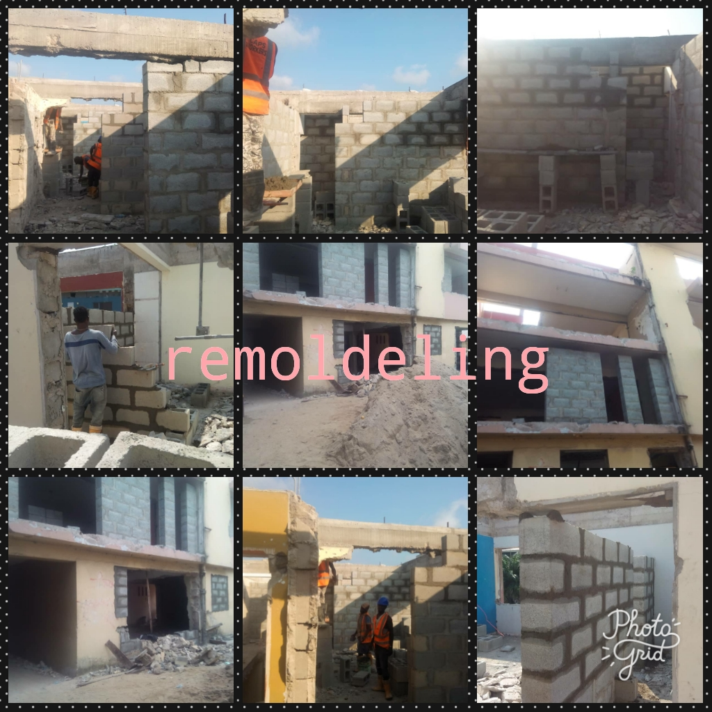
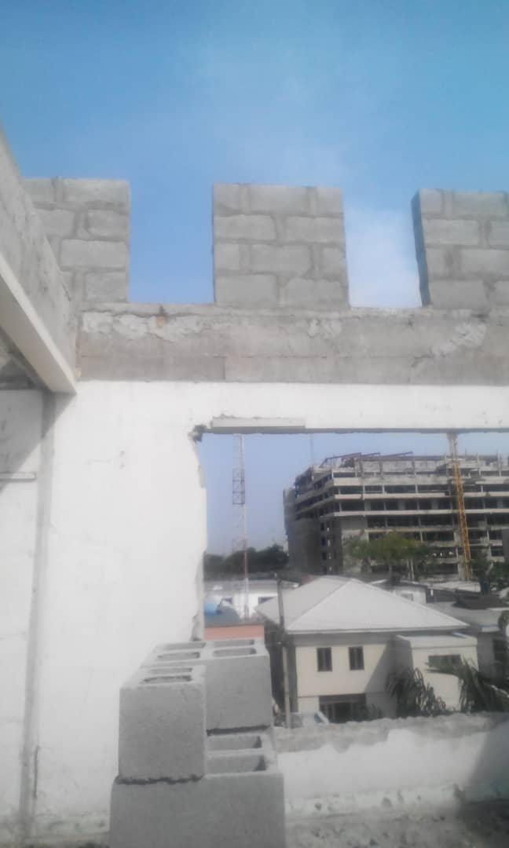
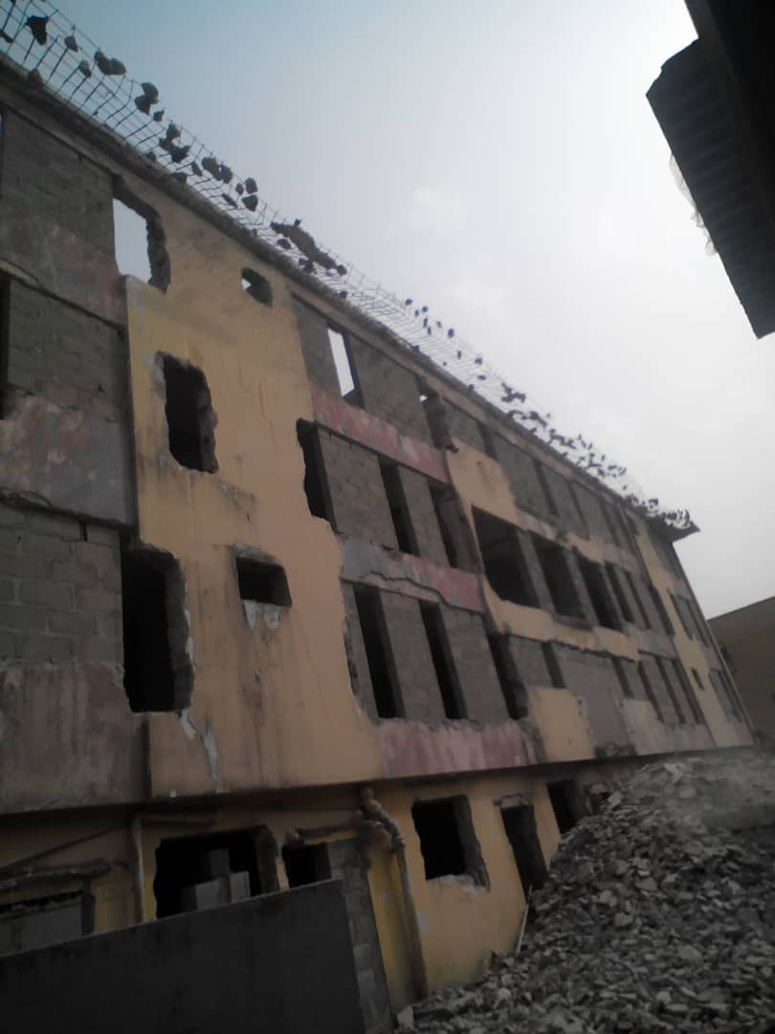
Ongoing Construction of 3 units of 2bedroom flat and a Maisonette with 2bedroom flat in Omole Phase 2, Lagos state.
Joint Venture

Slide 9
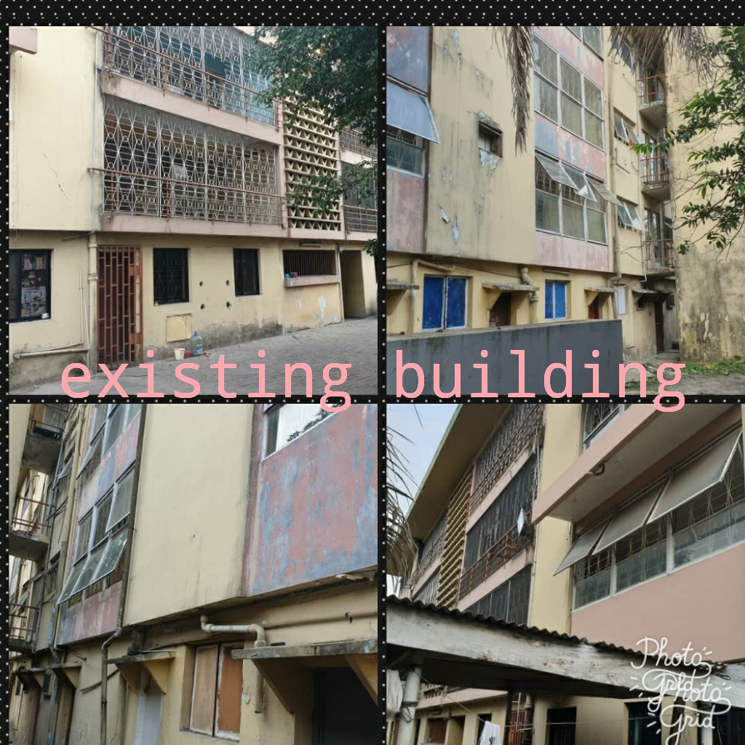
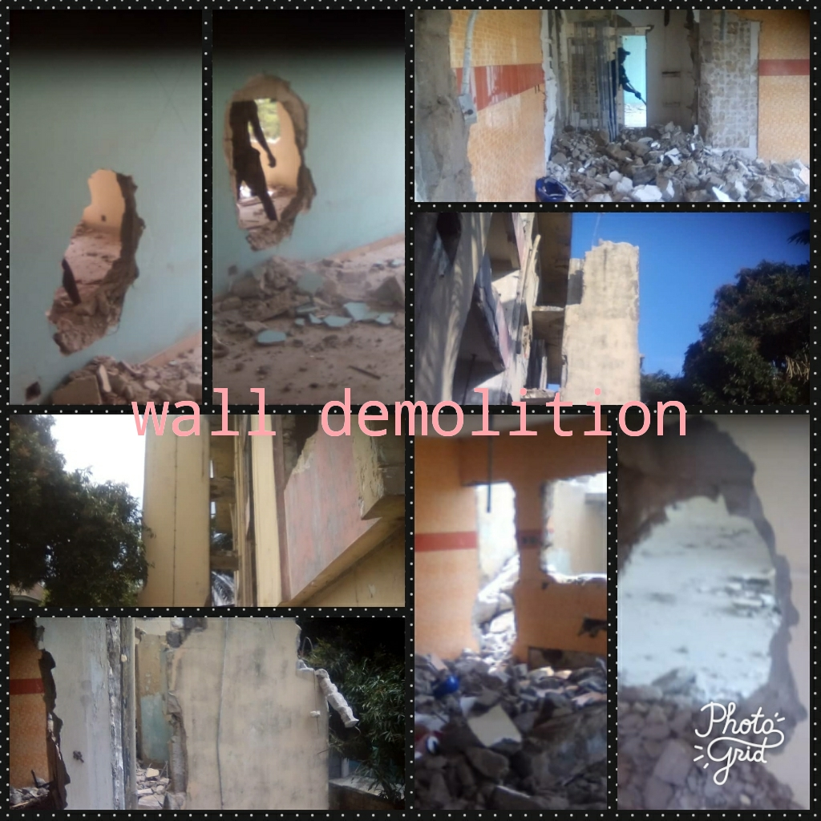
Ongoing Remodel of 8 flat to 4 Duplex of Maisonette at No 30, Ademola St, Ikoyi
Client: Commerce Alliance Property Solutions
Contract Sum: 352,000,000 Naira

Slide 10
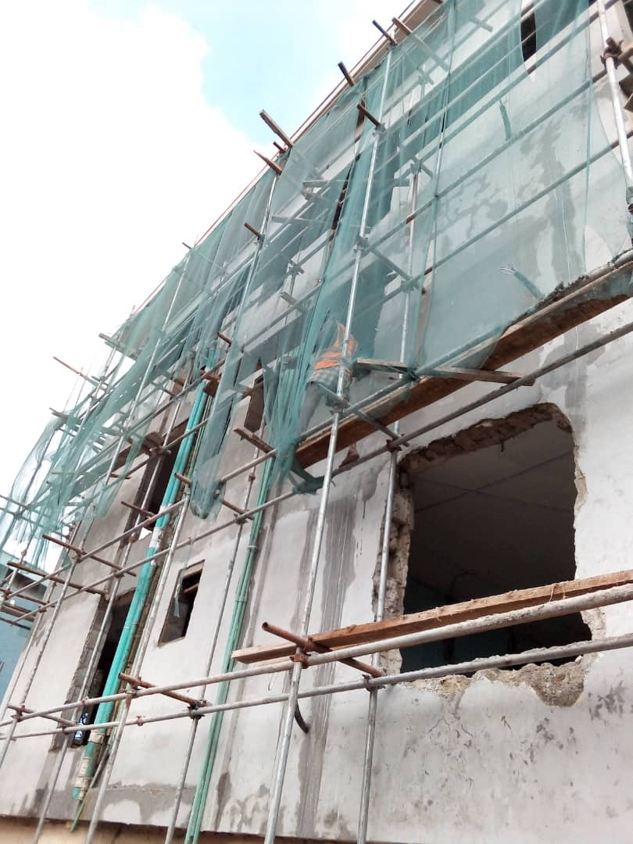
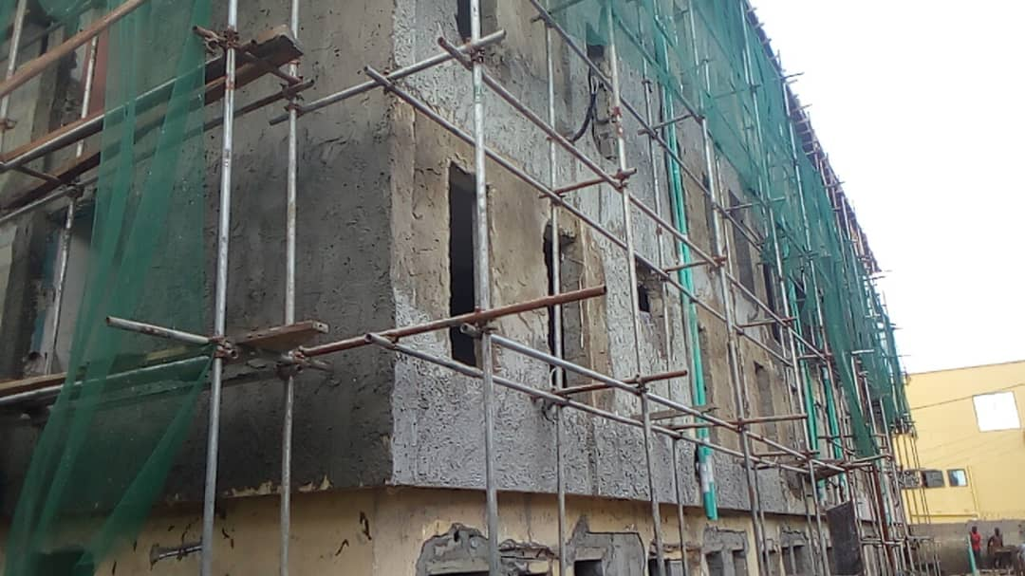
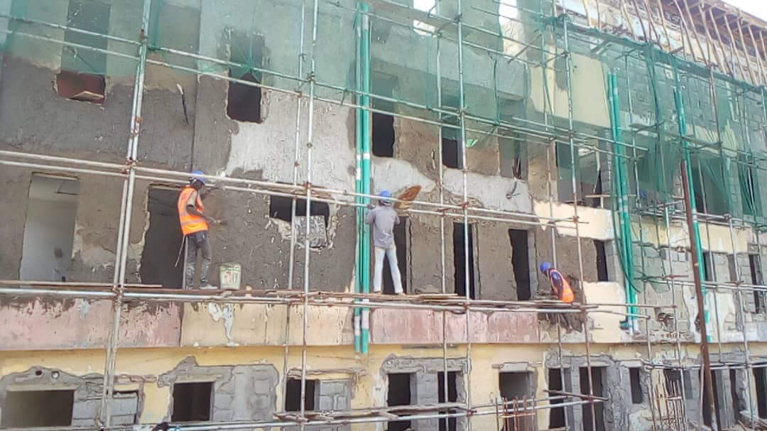
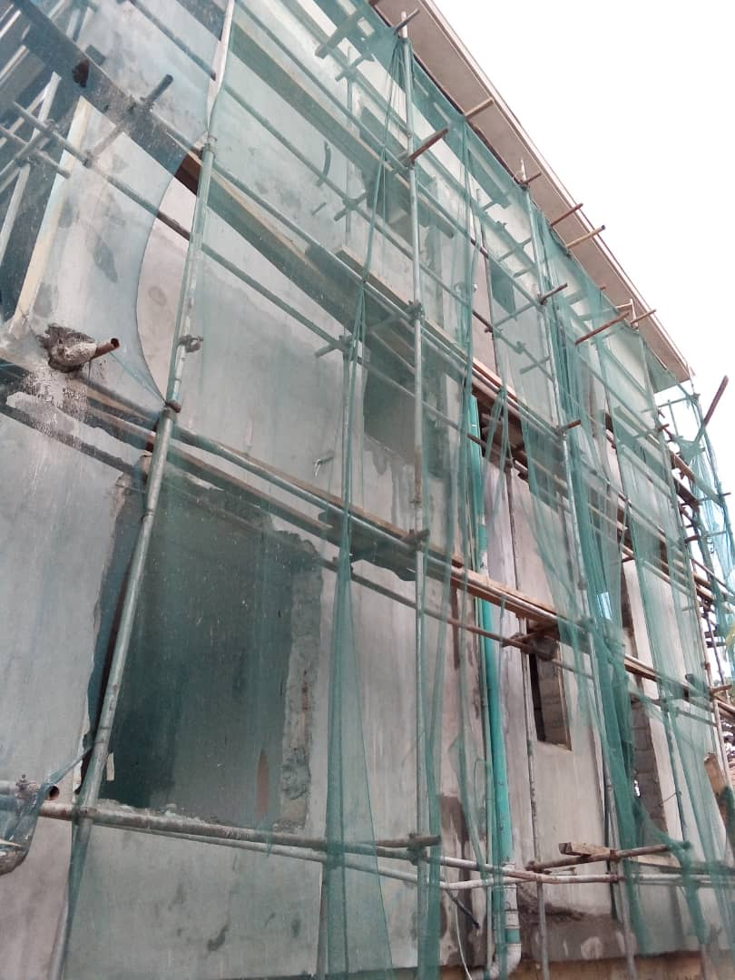
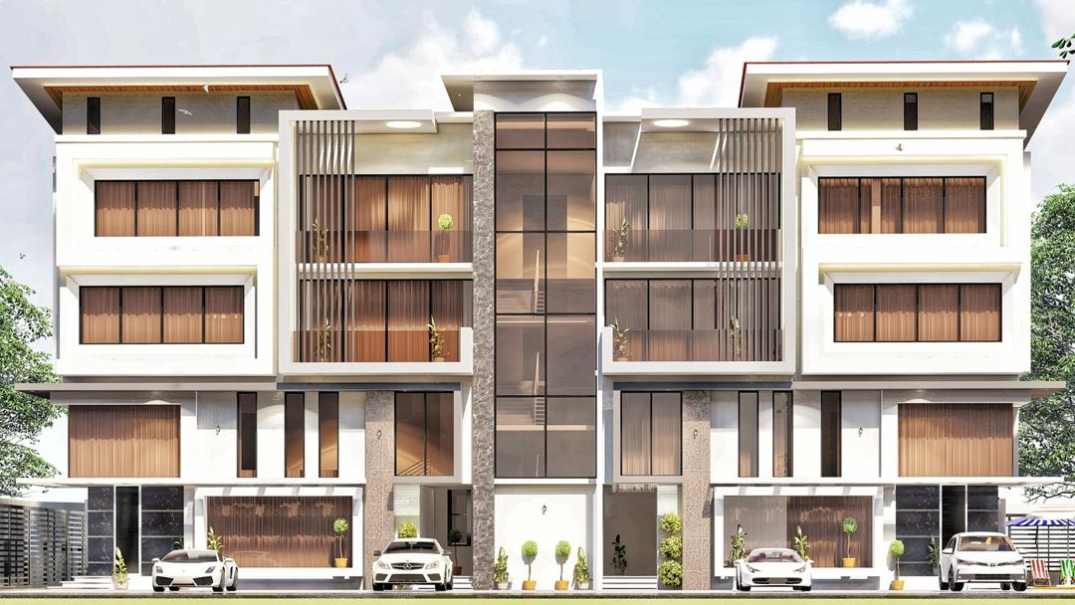
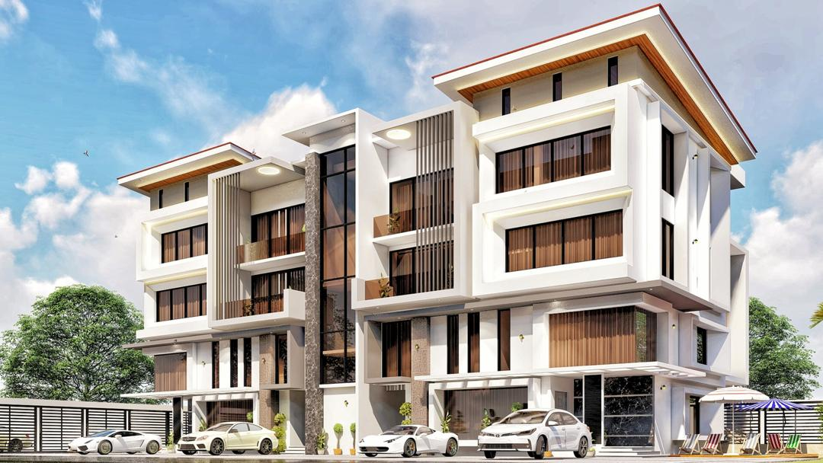
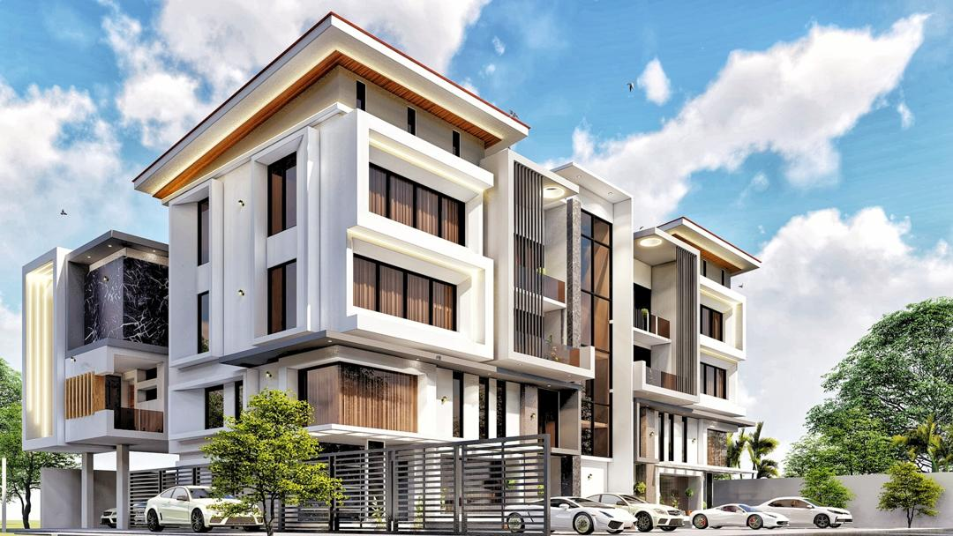
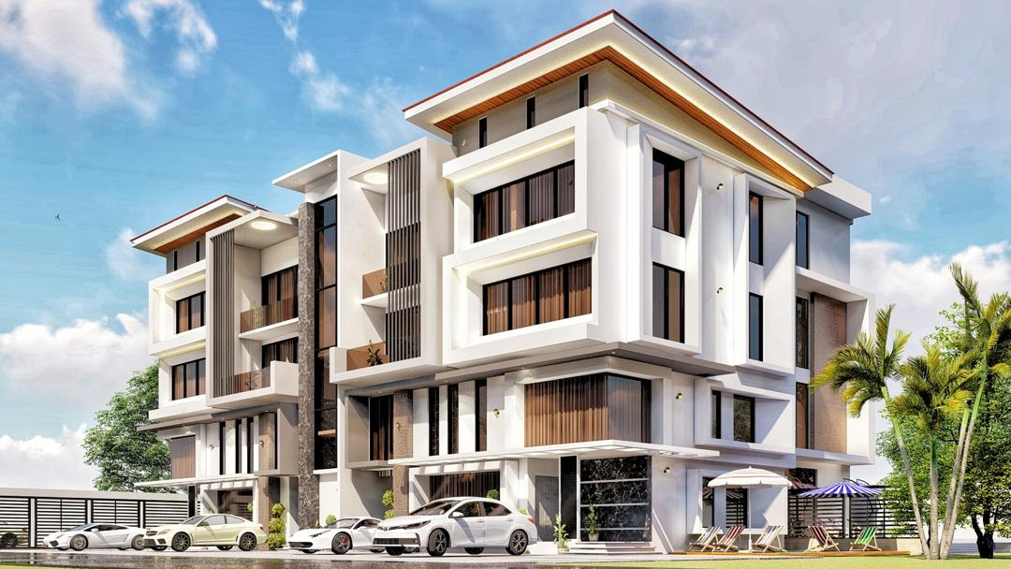
Ongoing Remodel of 8 flat to 4 Duplex of Maisonette at No 30, Ademola St, Ikoyi
Client: Commerce Alliance Property Solutions
Contract Sum: 352Million Naira

Slide 11
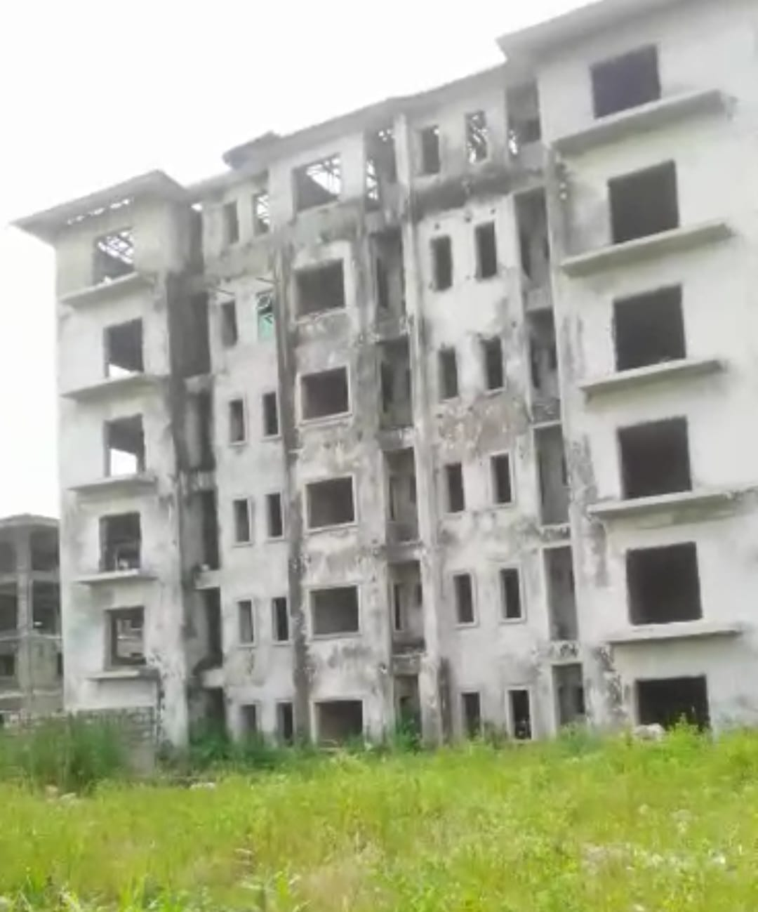
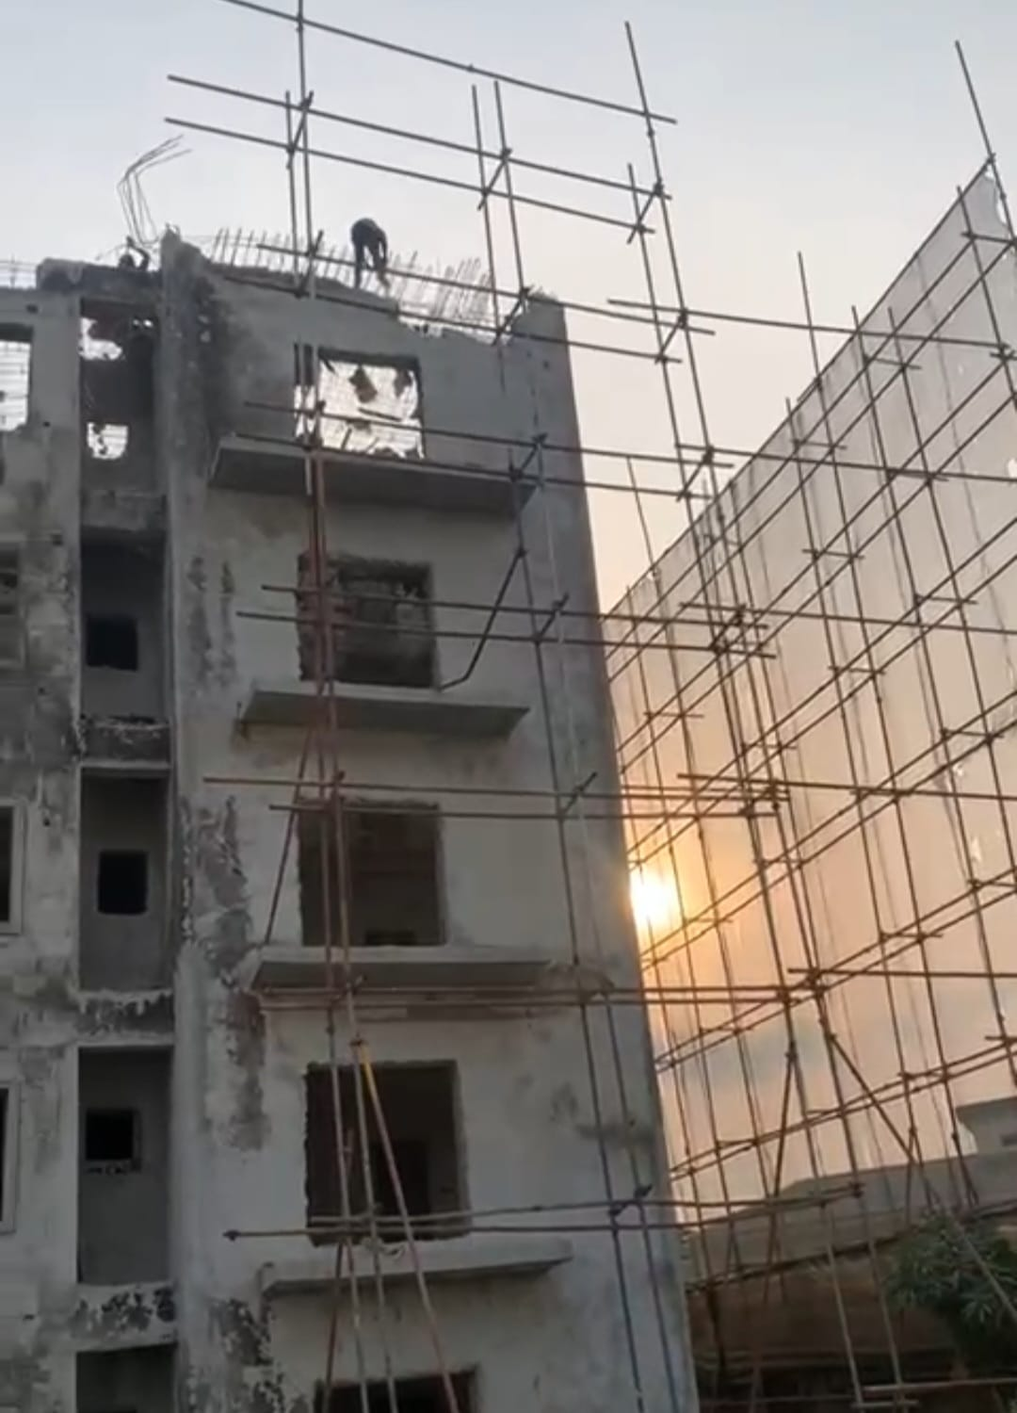
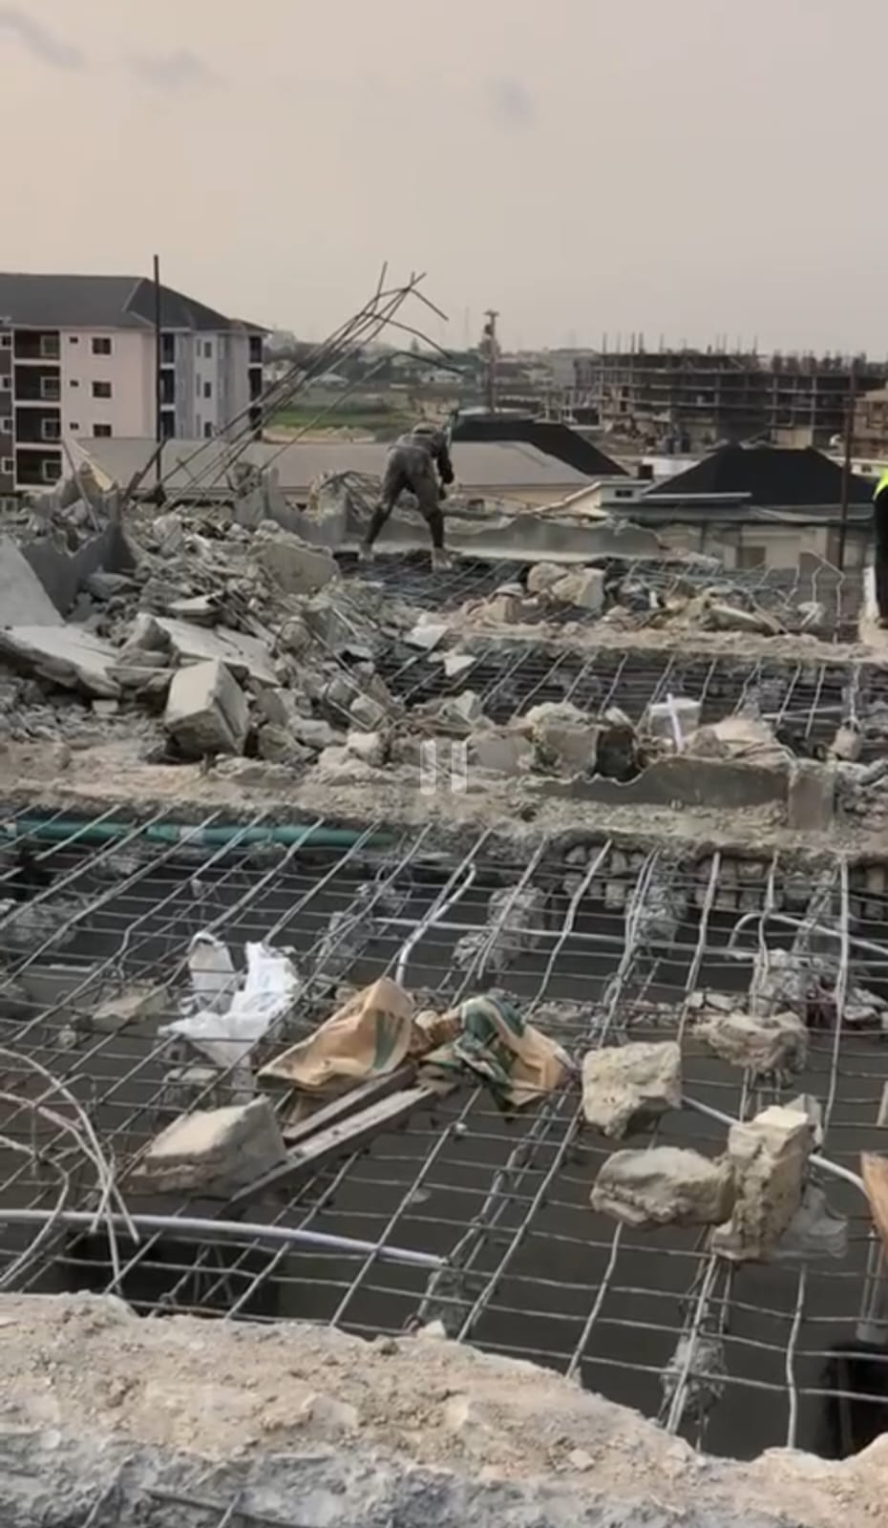

EXECUTED DEMOLITION WORKS: Demolition of G+5 at Horizon Extension, Kusanla Road, Lagos
Client: Lekki Gardens
Contract Sum: 8.2 Million Naira

Slide 12



Construction of Office Complex, Markudi, Benue State
Client: Insurance Trust Fund (NSITF) Office Complex, Markudi, Benue State
Contract Sum: 65 Million Naira
General Site and Reinforcement Preparation
Excavation of Foundation Trenches

Slide 13






Foundation Pad Footing
Foundation Column Starter
Foundation Block Setting
Foundation Block Setting Ongoin
Foundation Block Setting Ongoing
Foundation Block Setting Cont’d

Slide 14


Demolition and Construction of Seven Blocks of Flat, 6 Alara street, Sabo Yaba Lagos
Joint Venture.
Completed 2024
Existing Building Under Demolition
Removal of Rubbles

Slide 15




Ready for setting out after clearing
Excavation for Foundation
Placed Reinforcement and Formwork
Ground Beams to Raft Foundation

Slide 16






Existing Building Before Demolition
Ready for setting out after clearing
Ground floor Columns
First floor Beam & Slab Formwork
Blockwork on First Floor
Structure to Roof Level
Aluminum Roof Completed
Excavation for Foundation
Parapet Roof Works
Placed Reinforcement and Formwork

Slide 17






Plastering Completed
Ongoing Painting
Existing Building Before Demolition
Ready for setting out after clearing
Blockwork on First Floor
Structure to Roof Level
Finished Toilet
Finished Floor
Aluminum Roof Completed

Slide 18


Construction of 4 Blocks of Flat at Itanrin, Ijebu Ode, Ogun State
Client: Dr. Ibrahim Odunlade
Contract Sum: 107 Million Naira
Building Under Construction
Ground Beams to Raft Foundation

Slide 19





Roof Installation
Screeding and Painting Works
Screeding and Painting Works
Finished Dinnin Area
Finished Sitting Room
Finished Closet

Slide 20


Supply and Installation Paving Stone for Road Construction at Makoko Adekubnle, Yaba.
Client: Hansmag Nigeria Limited/Lagos State Government
Contract Sum: 31 Million Naira
Removal Top Soil and Dumped Refuse
Excavation of Specified Depth

Slide 21





Roof Installation
Screeding and Painting Works
Drainage Installation
Drainage Cover Concreting
Levelling & Compaction
Road Surface to Receive Stones
Finished Road Paving Stone Surface

Slide 22

Demolition and cart away of Three-Storey Building at Ebute-Ero,Police Post, Lagos Island, Lagos State.
Client: Arisekola Family/Lagos State Government
Contract Sum: 7.8 Million Naira

Slide 23

Demolition of Three-Storey Building at Adeniji, Lagos State.
Client: Hansmag Nigeria Limited/Lagos State Government
Contract Sum: 31 Million Naira

Slide 24
Our List Of Equipments
2 cutting machines 6. 1 leveling instrument
1 concrete mixer 7. 7.5KVA generator
400pcs of scaffolds pipes
287pcs of acrow pipes
2 concrete vibrator

Slide 25
Our Statutory Certificates
Our understanding of eligibility requirements as applicable to our businesses is extensive, hence we make sure all statutory obligations are satisfied.

Slide 26



Slide 27



Slide 28



Slide 29



Slide 30



Slide 32



Slide 33



Slide 34


Slide 36



Slide 37
EDOLARK LIMITED
Get in Touch
With Us
We are ready to lead you into achieving your goals.
Plot 1 Ogunyemi Pedro, Gbagada,
Lagos state.
info@edolark.com
+2348062125925

